Slide 1
An NSS Audio-Visual
Library Presentation
Papua New Guinea 1982
S738 96 Slides 2/07/2021
Notes:
This is the story of the first American—organized caving expedition to Papua New Guinea: the Mt. Kaijende expedition of 1982.

Slide 3
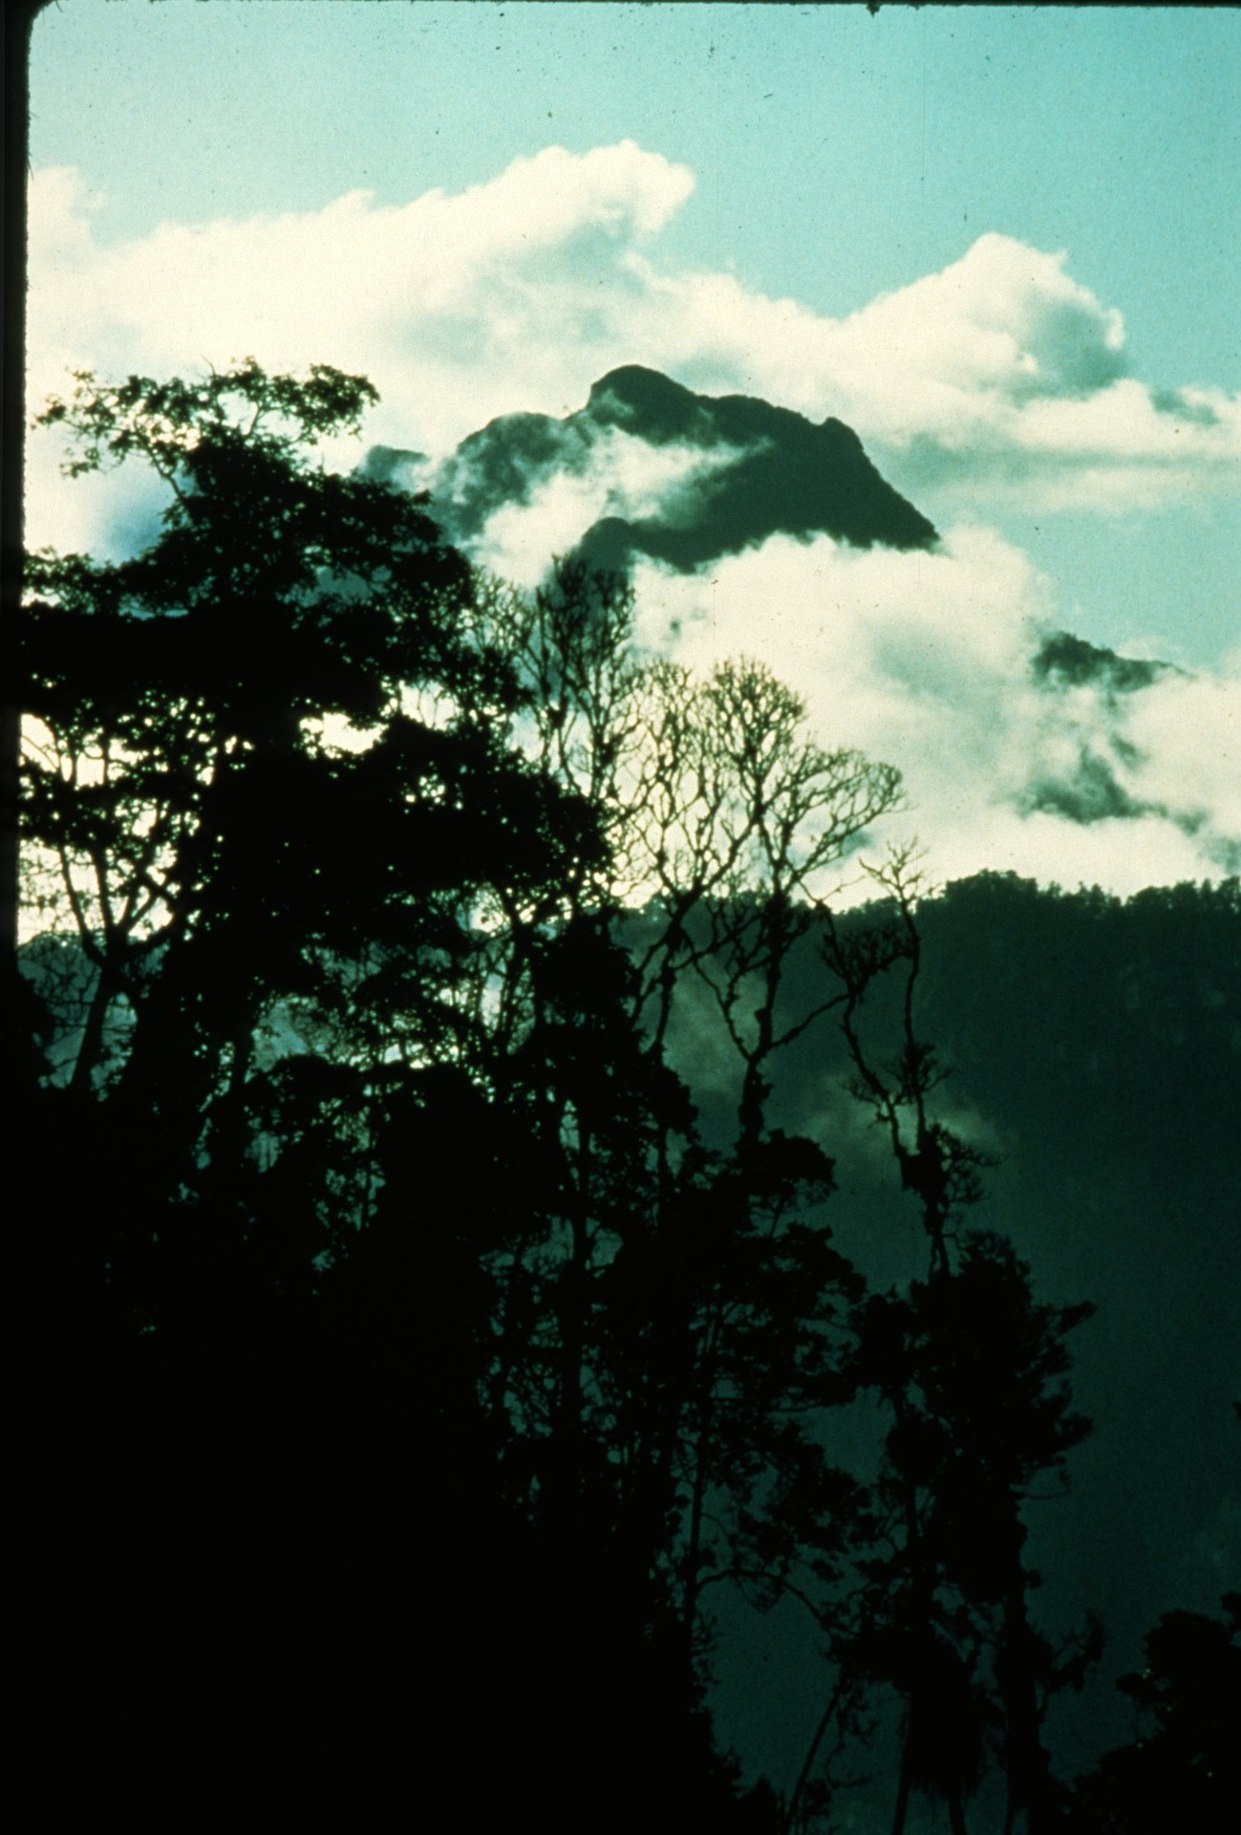
Notes:
Mt. Kaijende rises 12,433’ above the jungles of the western highlands of Papua New Guinea.

Slide 4
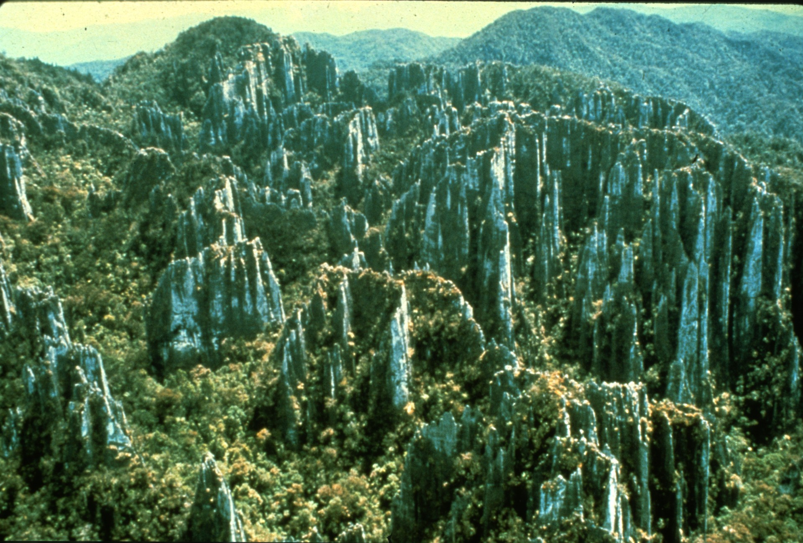
Notes:
Extensive pinnacle karst piqued the interest of expedition organizers Neil Montgomery and Donna Mrockowski.

Slide 5
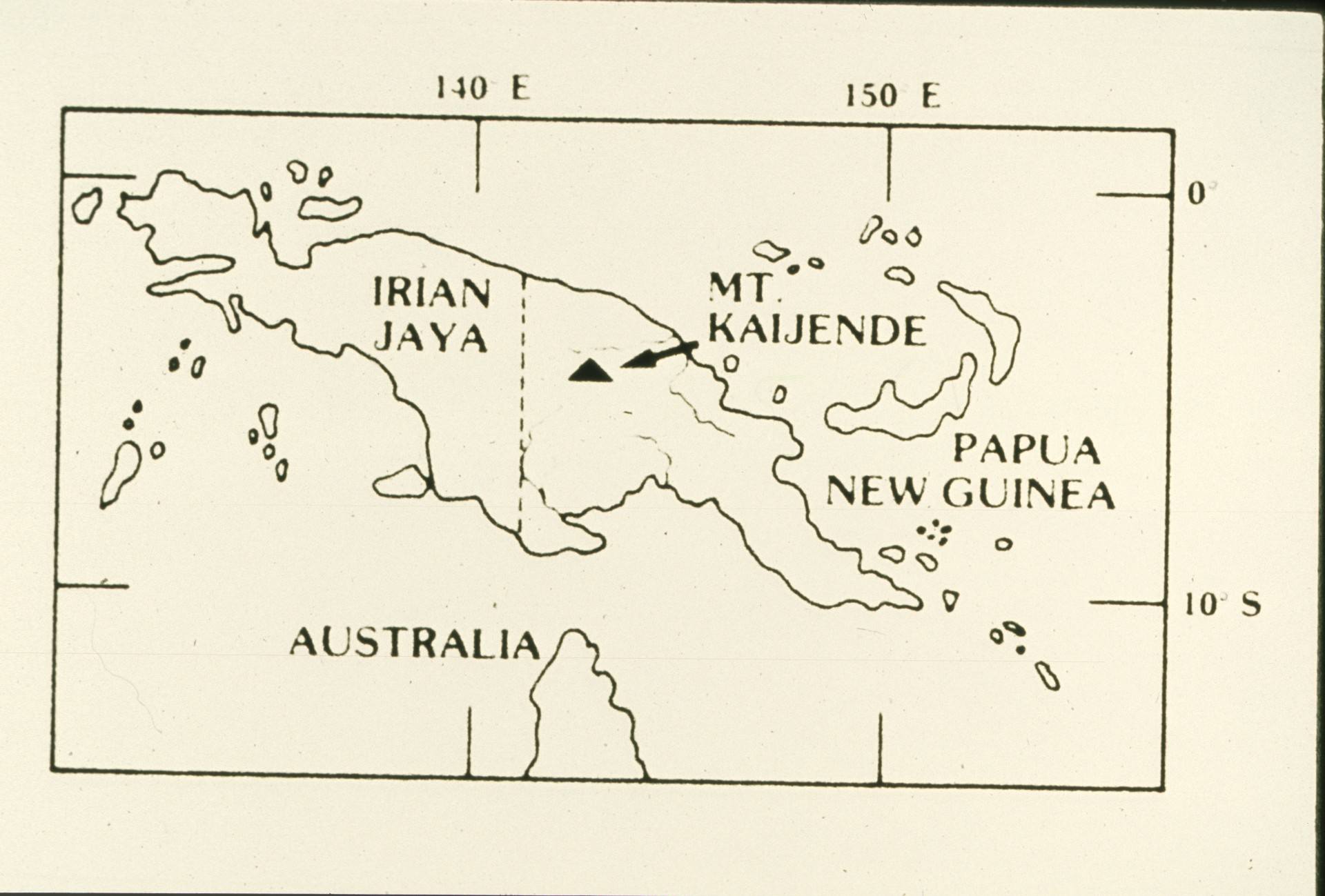
Notes:
The country of Papua New Guinea occupies the eastern half of the island, just north of Australia. The Kaijende area lies about 100 miles west of the town of Mt. Hagan.

Slide 6
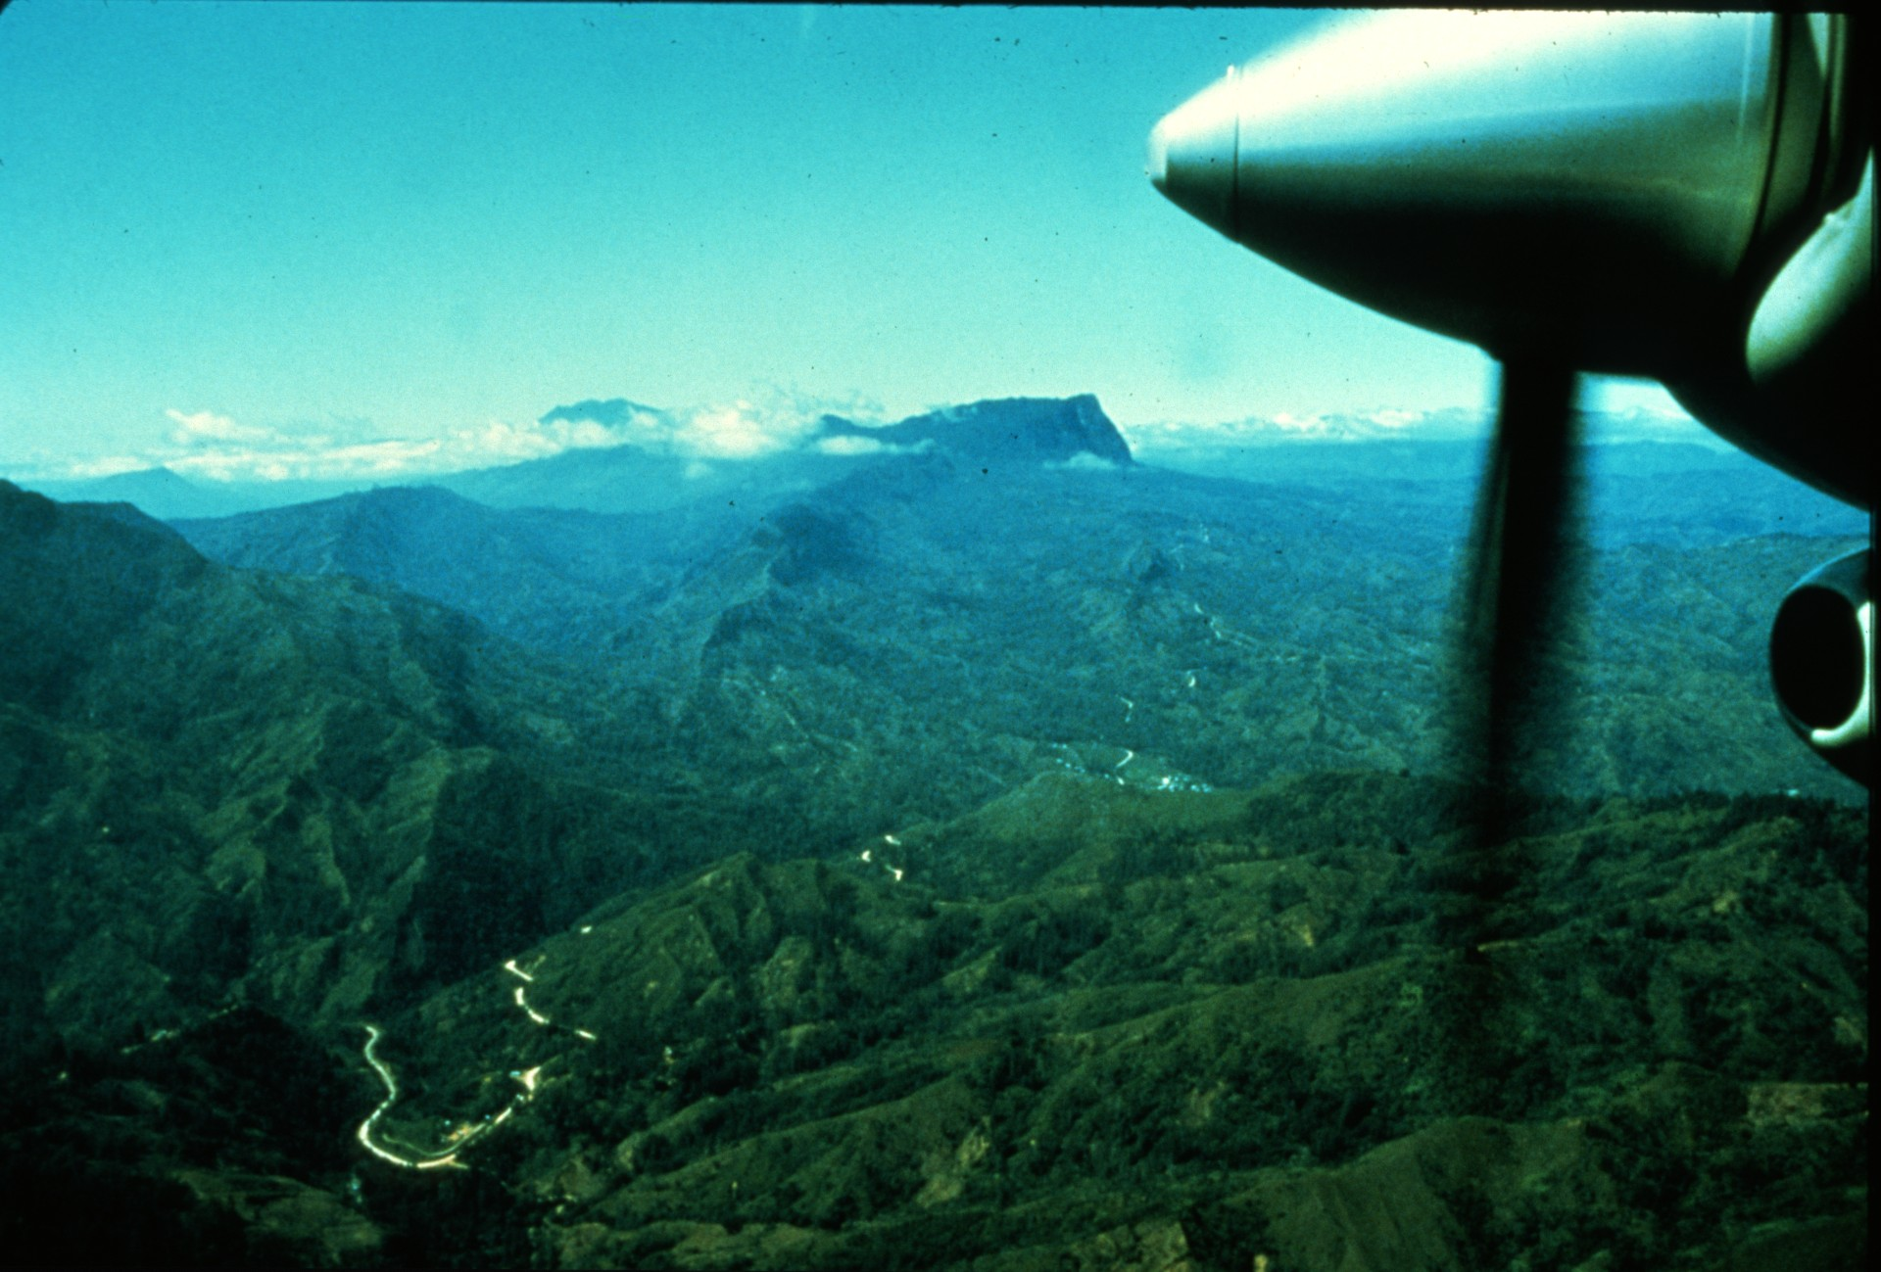
Notes:
The flight to Mt. Hagan provided expedition members their first glimpse of an area first seen by westerners less than 50 years ago.

Slide 7
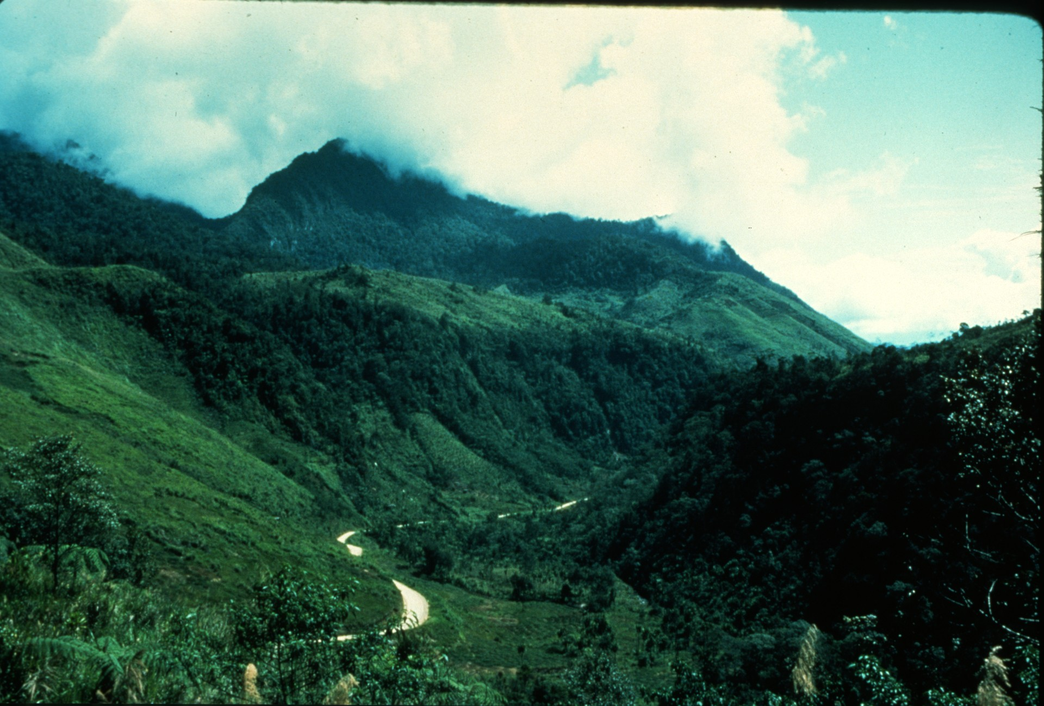
Notes:
From Mt. Hagan the journey continued another 8 hours along the "Highlands Highway": a rugged dirt and mud 4 wheel drive road.

Slide 8
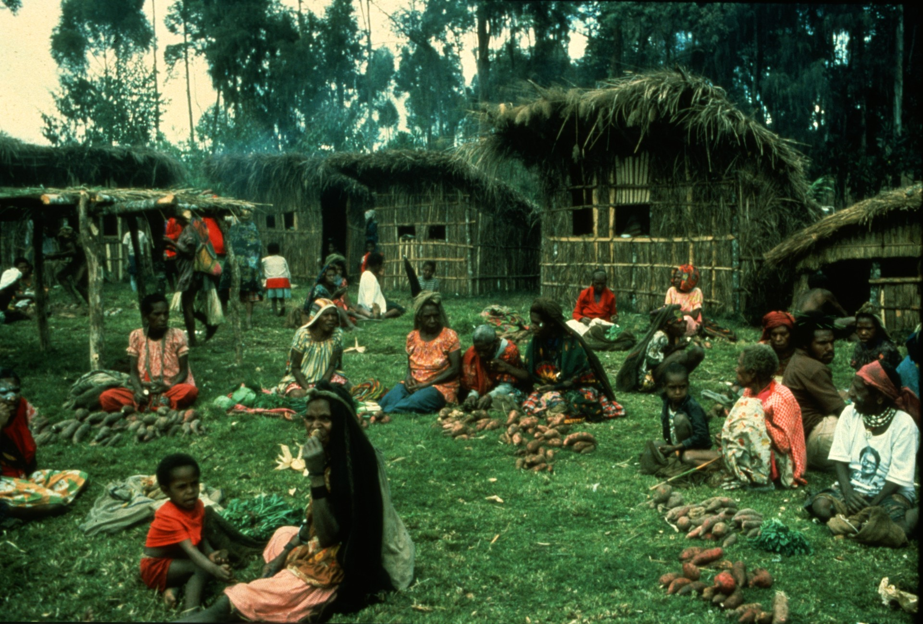
Notes:
The route ‘passed through many small villages complete with thatch huts and natives selling kau-kau, a sweet potato.

Slide 9
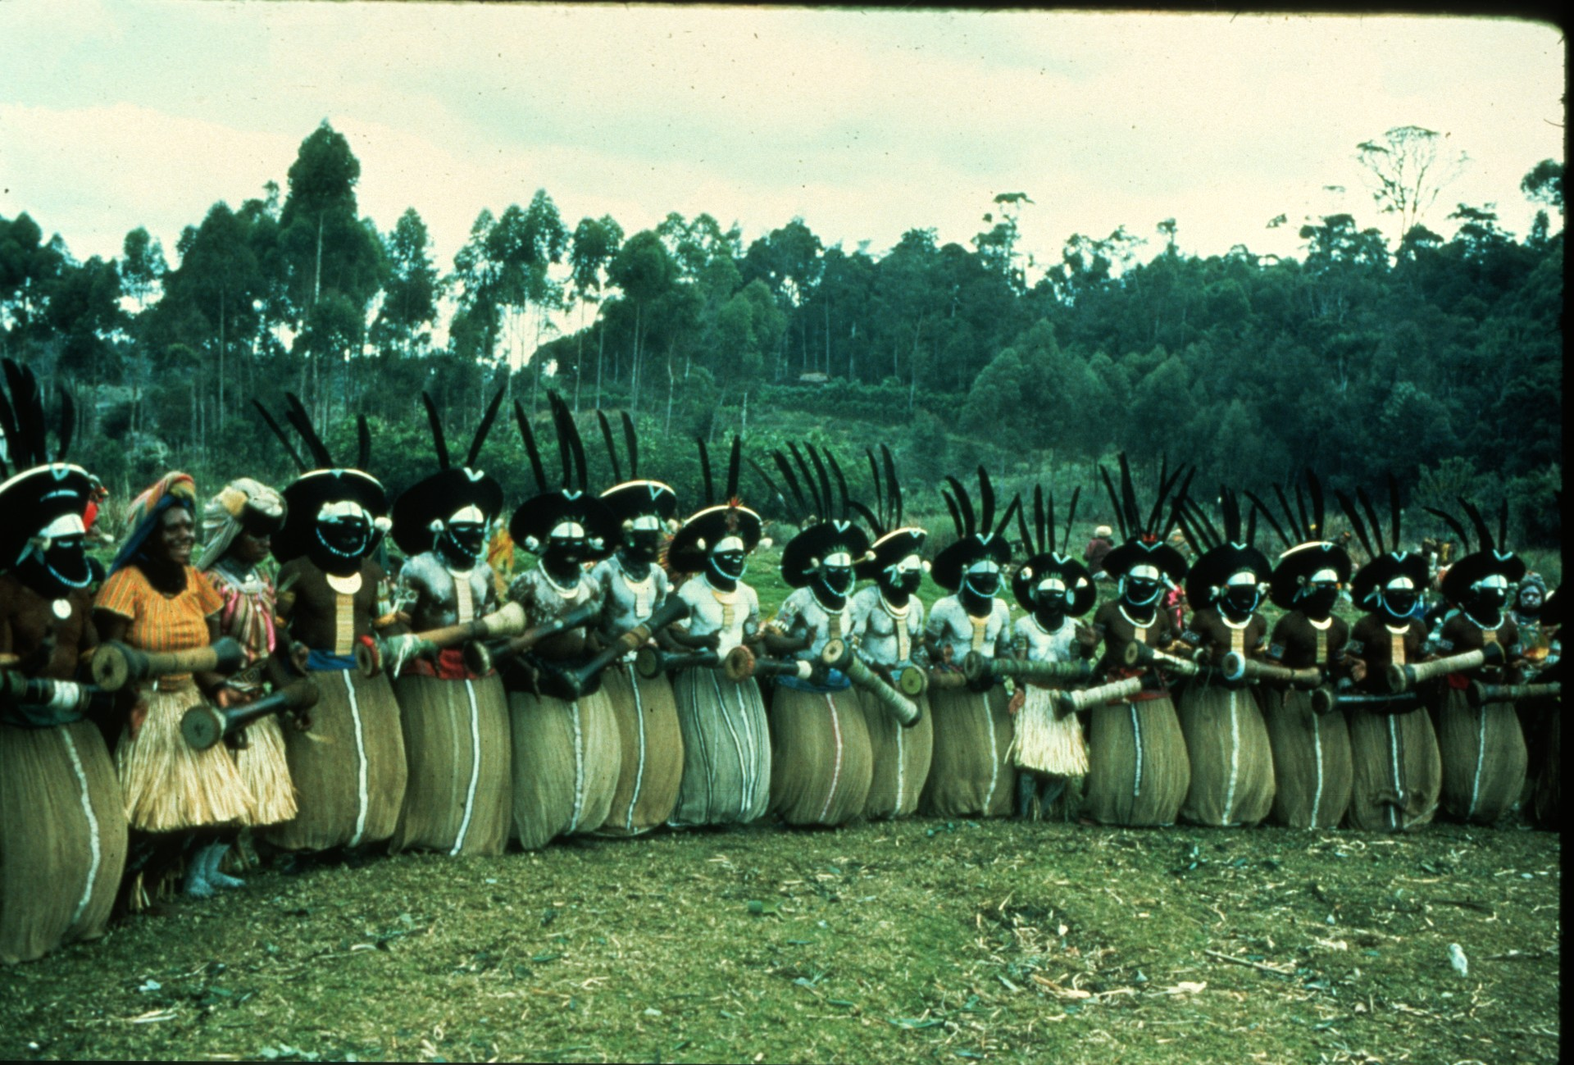
Notes:
One of the highlights of the journey was encountering a local sing-sing, or tribal celebration.

Slide 10
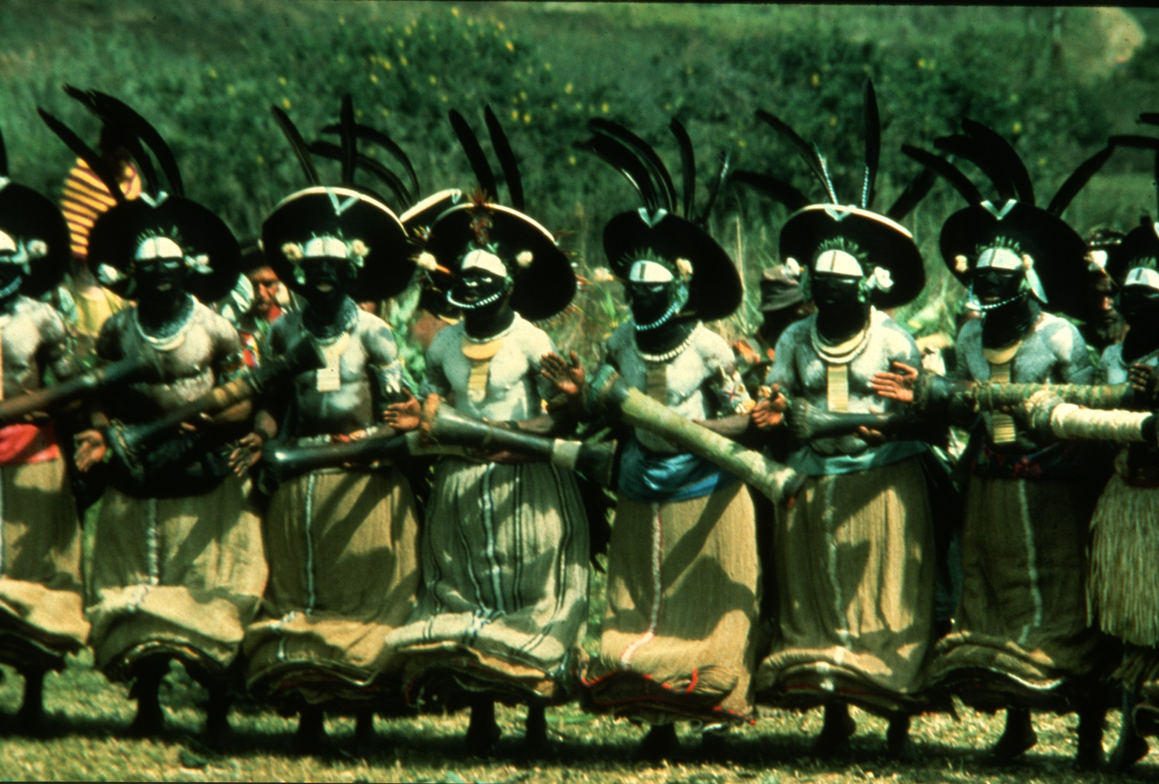
Notes:
The focal point of the sing-sing was a line of swaying, drum-beating tribesmen sporting wigs of human hair adorned with bird-of-paradise feathers.

Slide 11
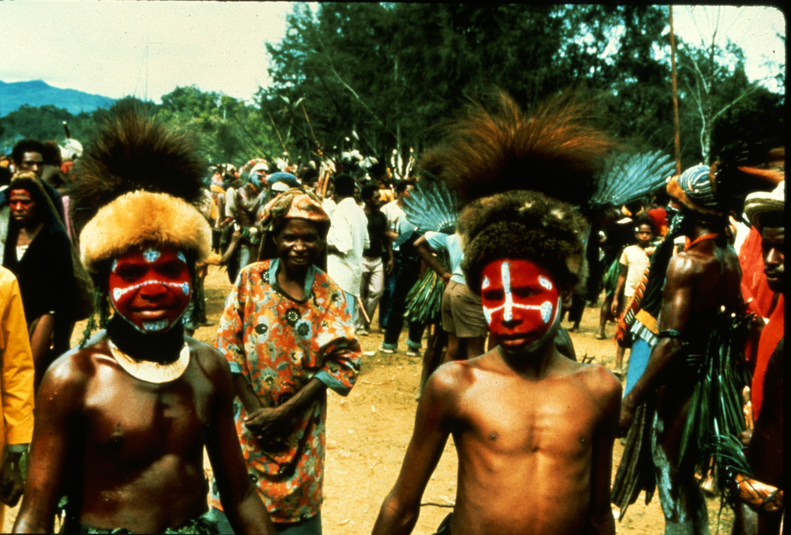
Notes:
The young...

Slide 12
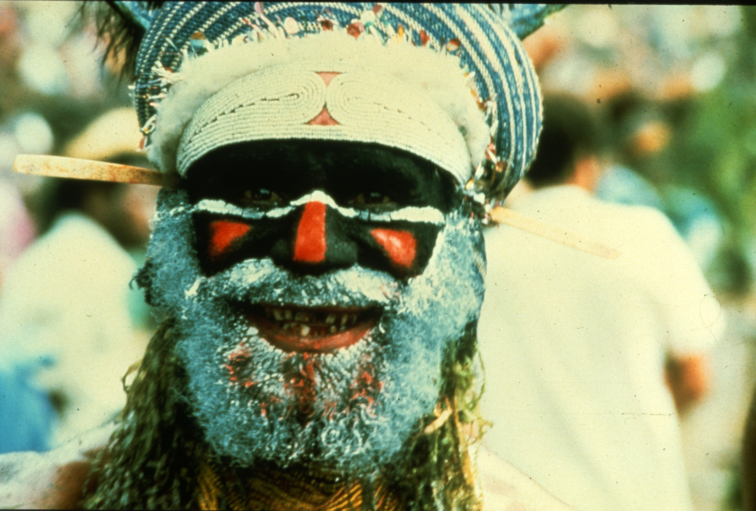
Notes:
and the old...

Slide 13
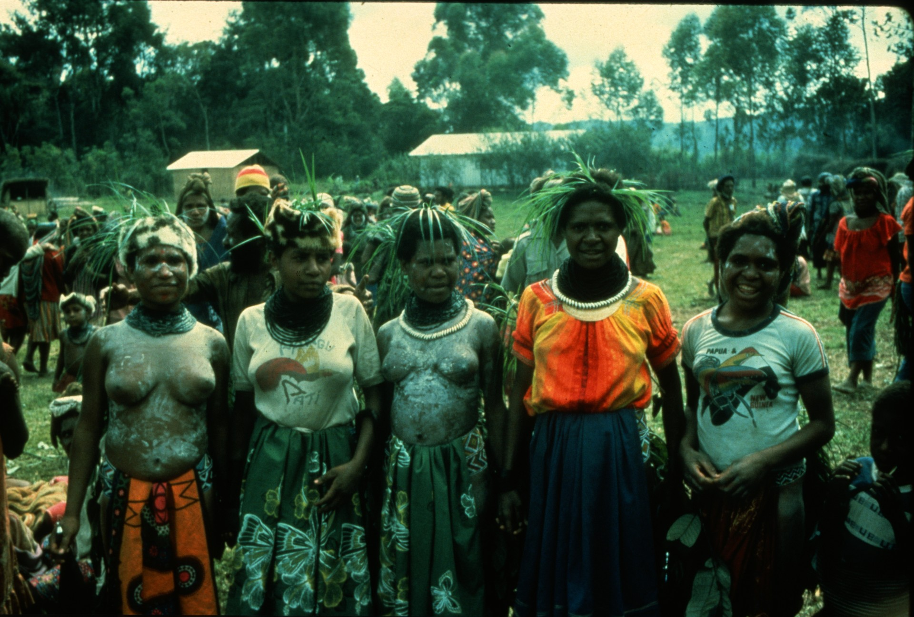
Notes:
the women in their "lap-laps“...

Slide 14
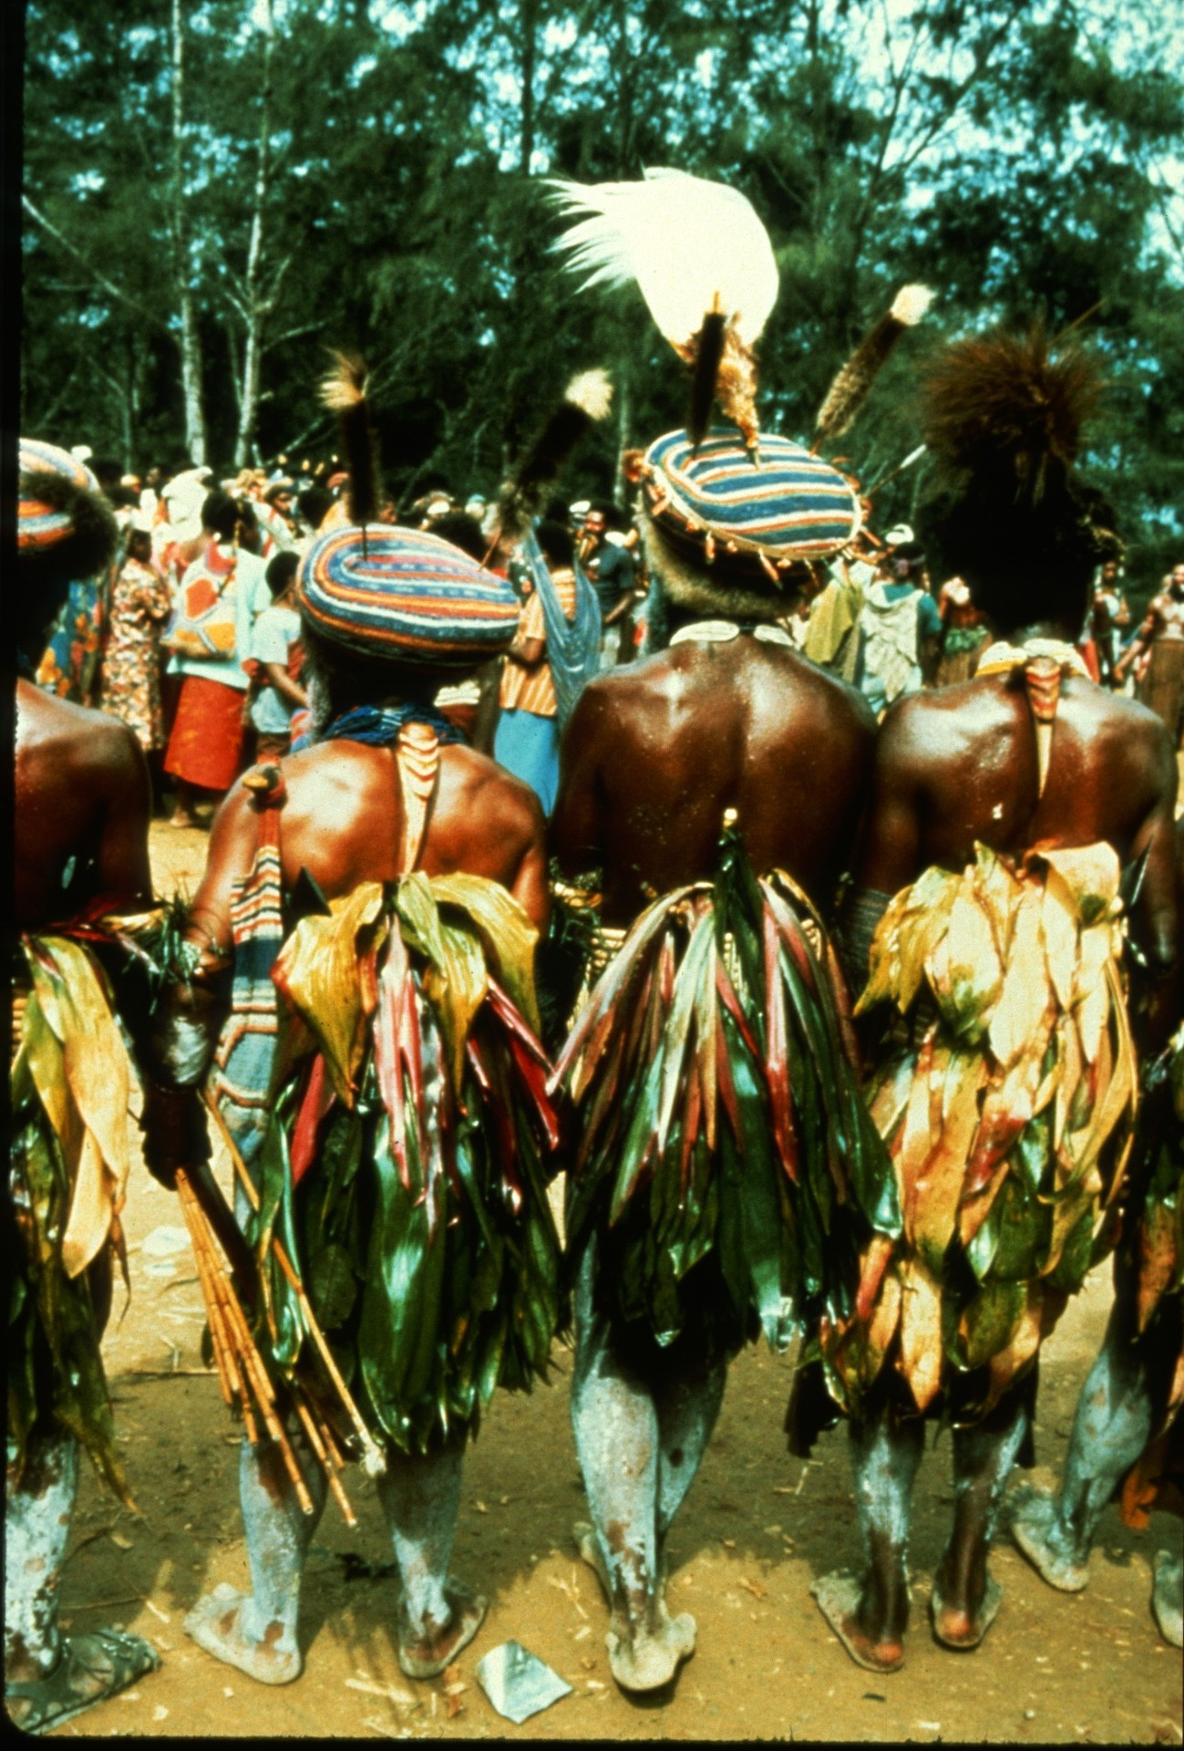
Notes:
and the men in their "arse-grass"....

Slide 15
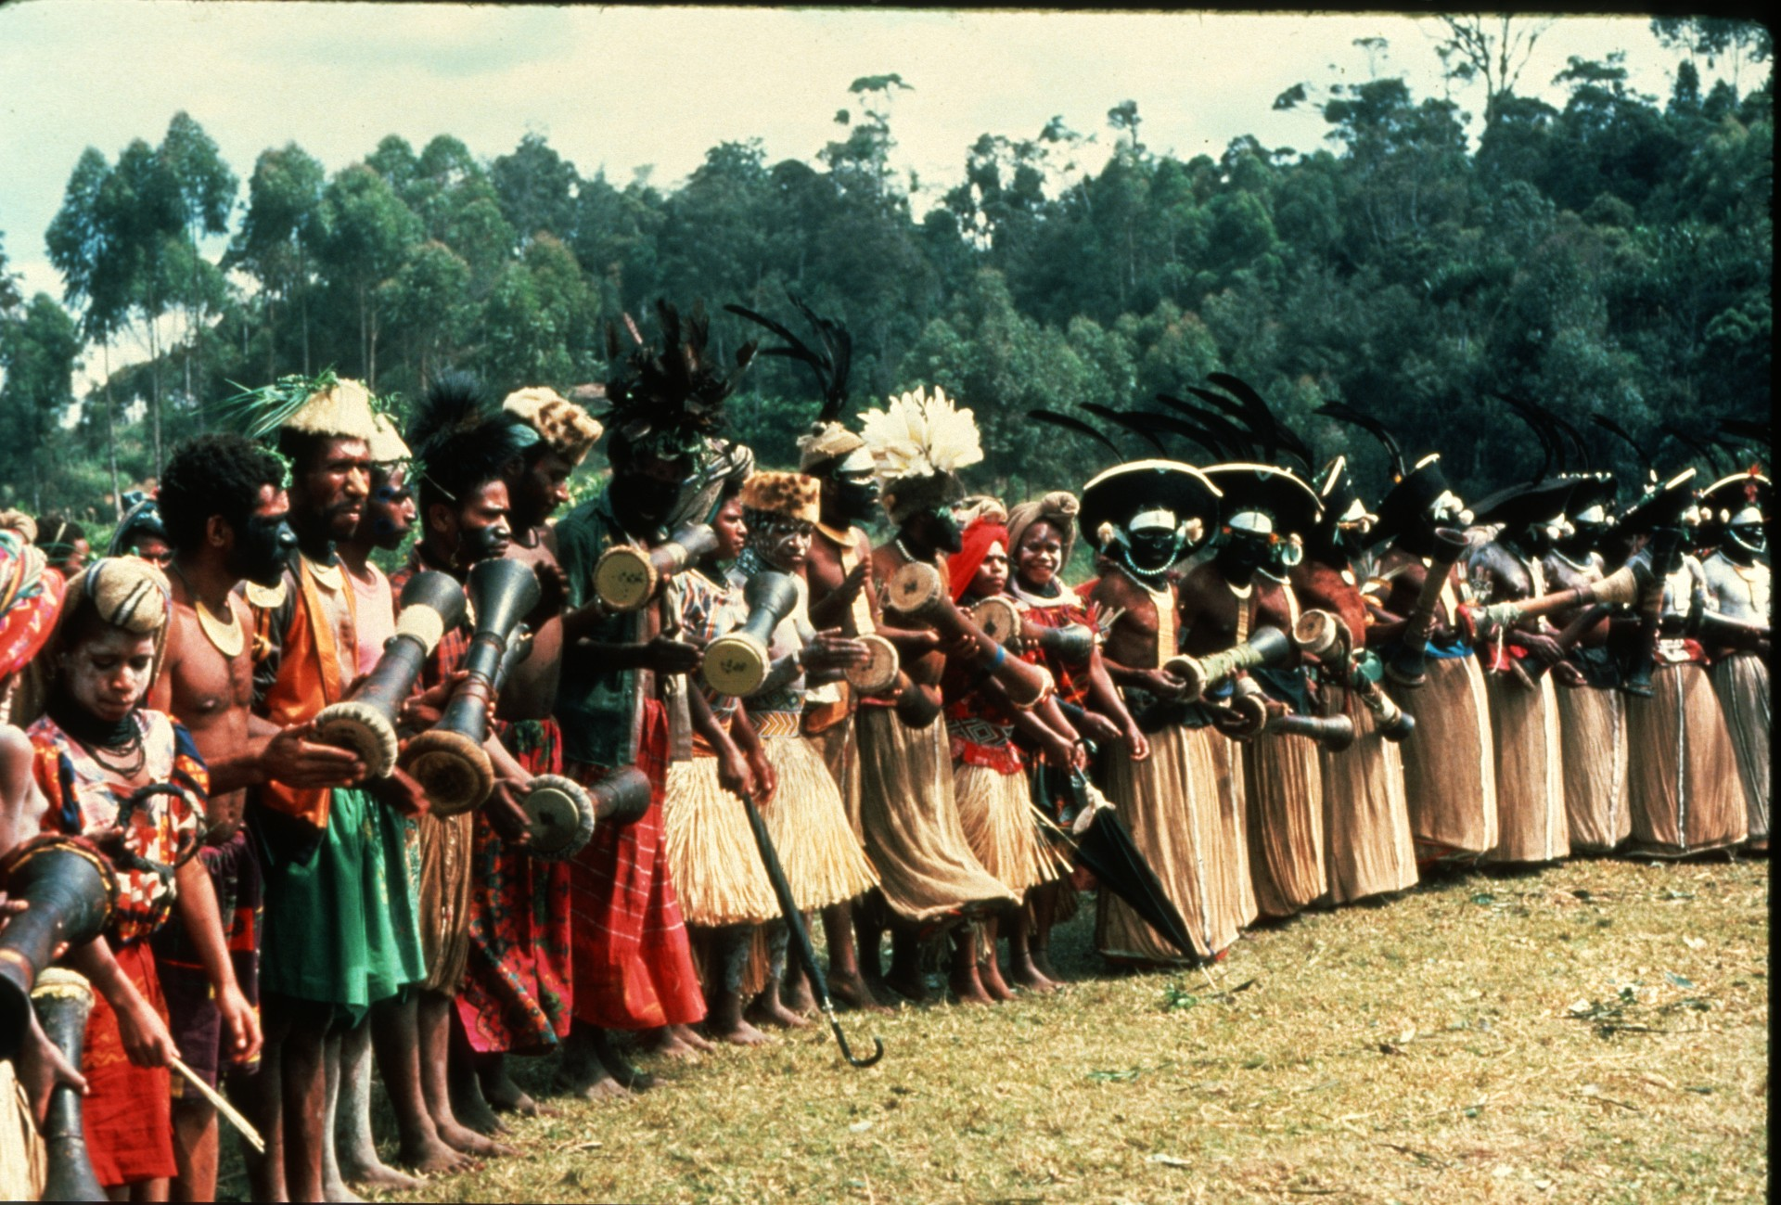
Notes:
all got into the act.

Slide 16
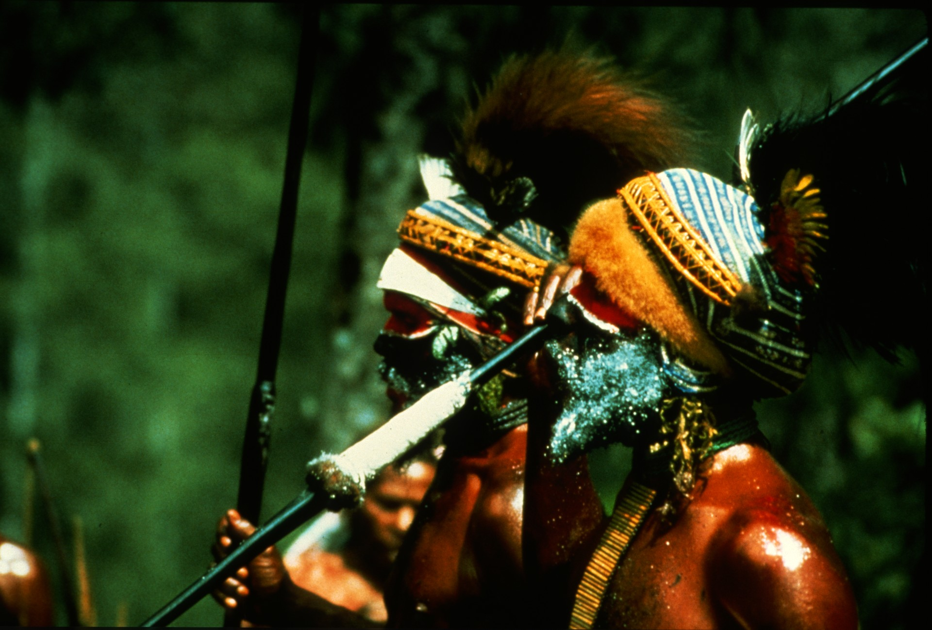
Notes:
Further along the road more excitement occurred when the open-backed trucks ferrying expedition members were endangered by spear-throwing tribesmen in the midst of a tribal war.

Slide 17
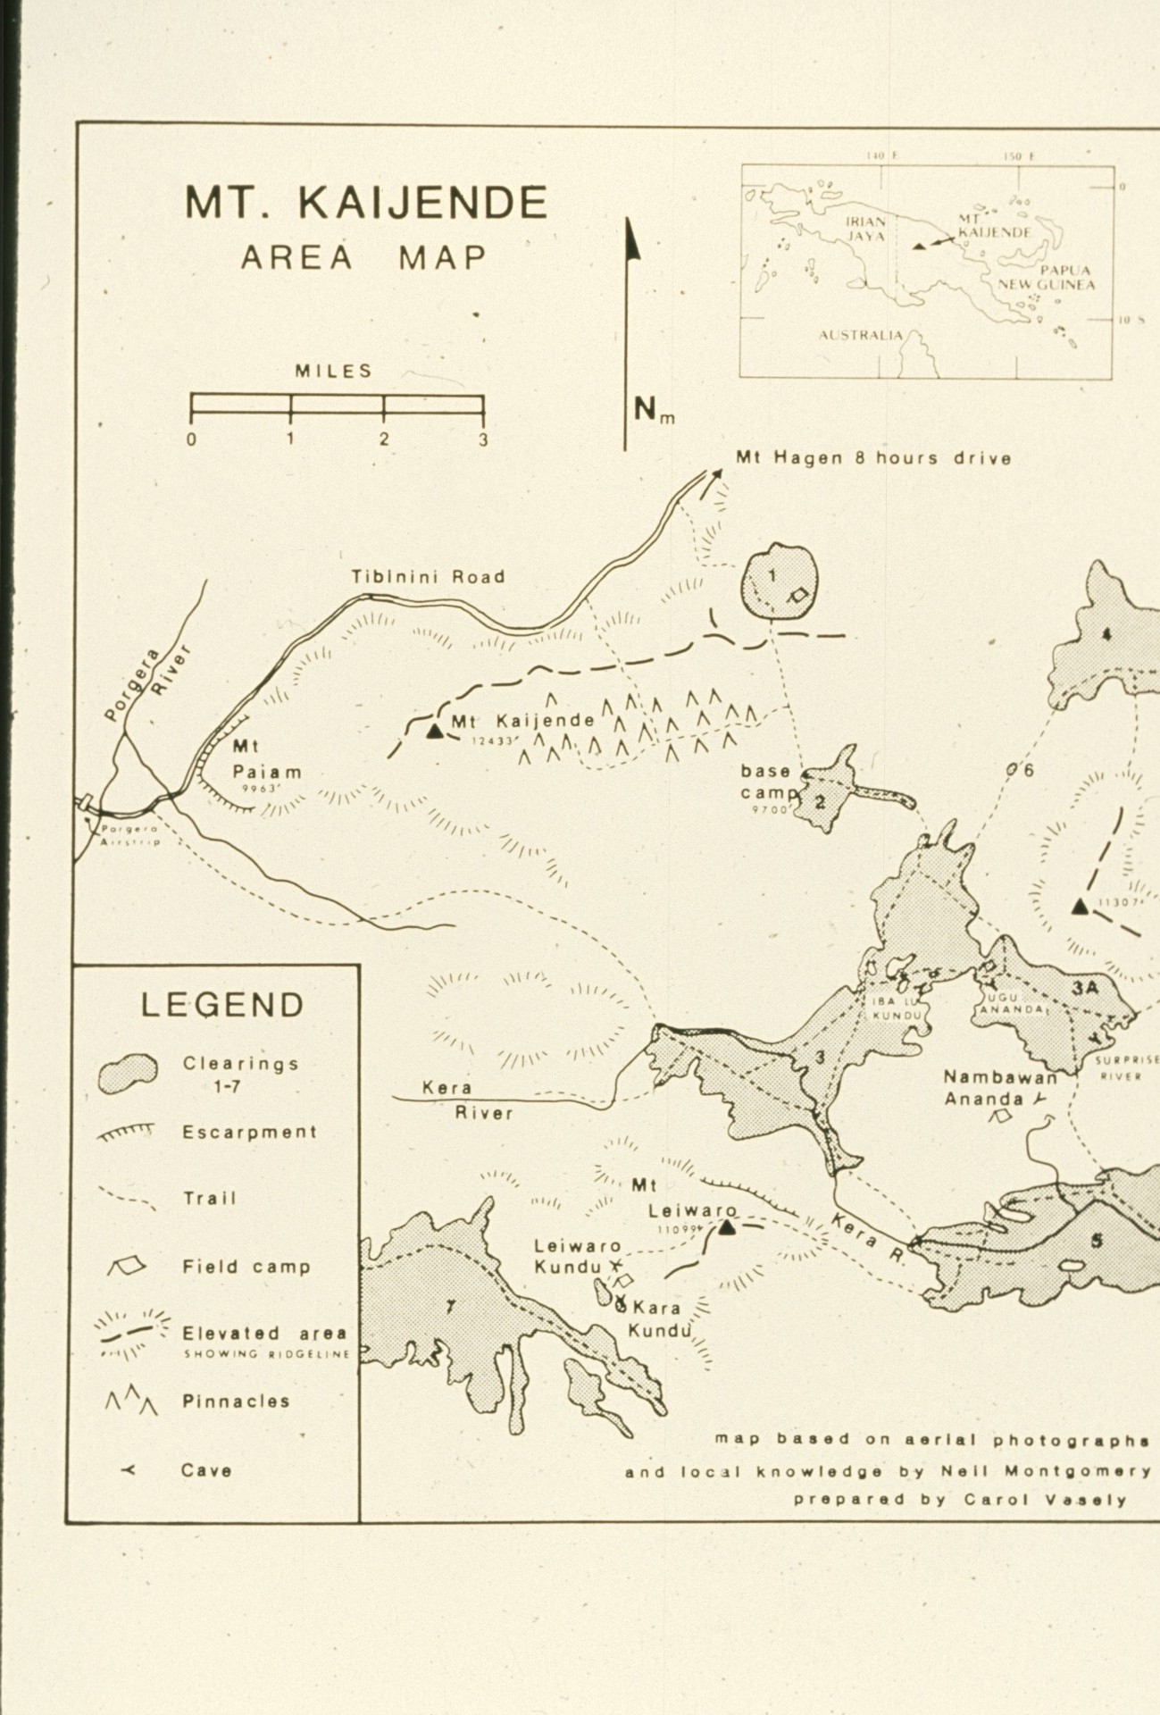
Notes:
With the drive completed, base camp still lay two day's trek. A site had been chosen at 9700' in one of the large alpine clearings which characterized the area.

Slide 18
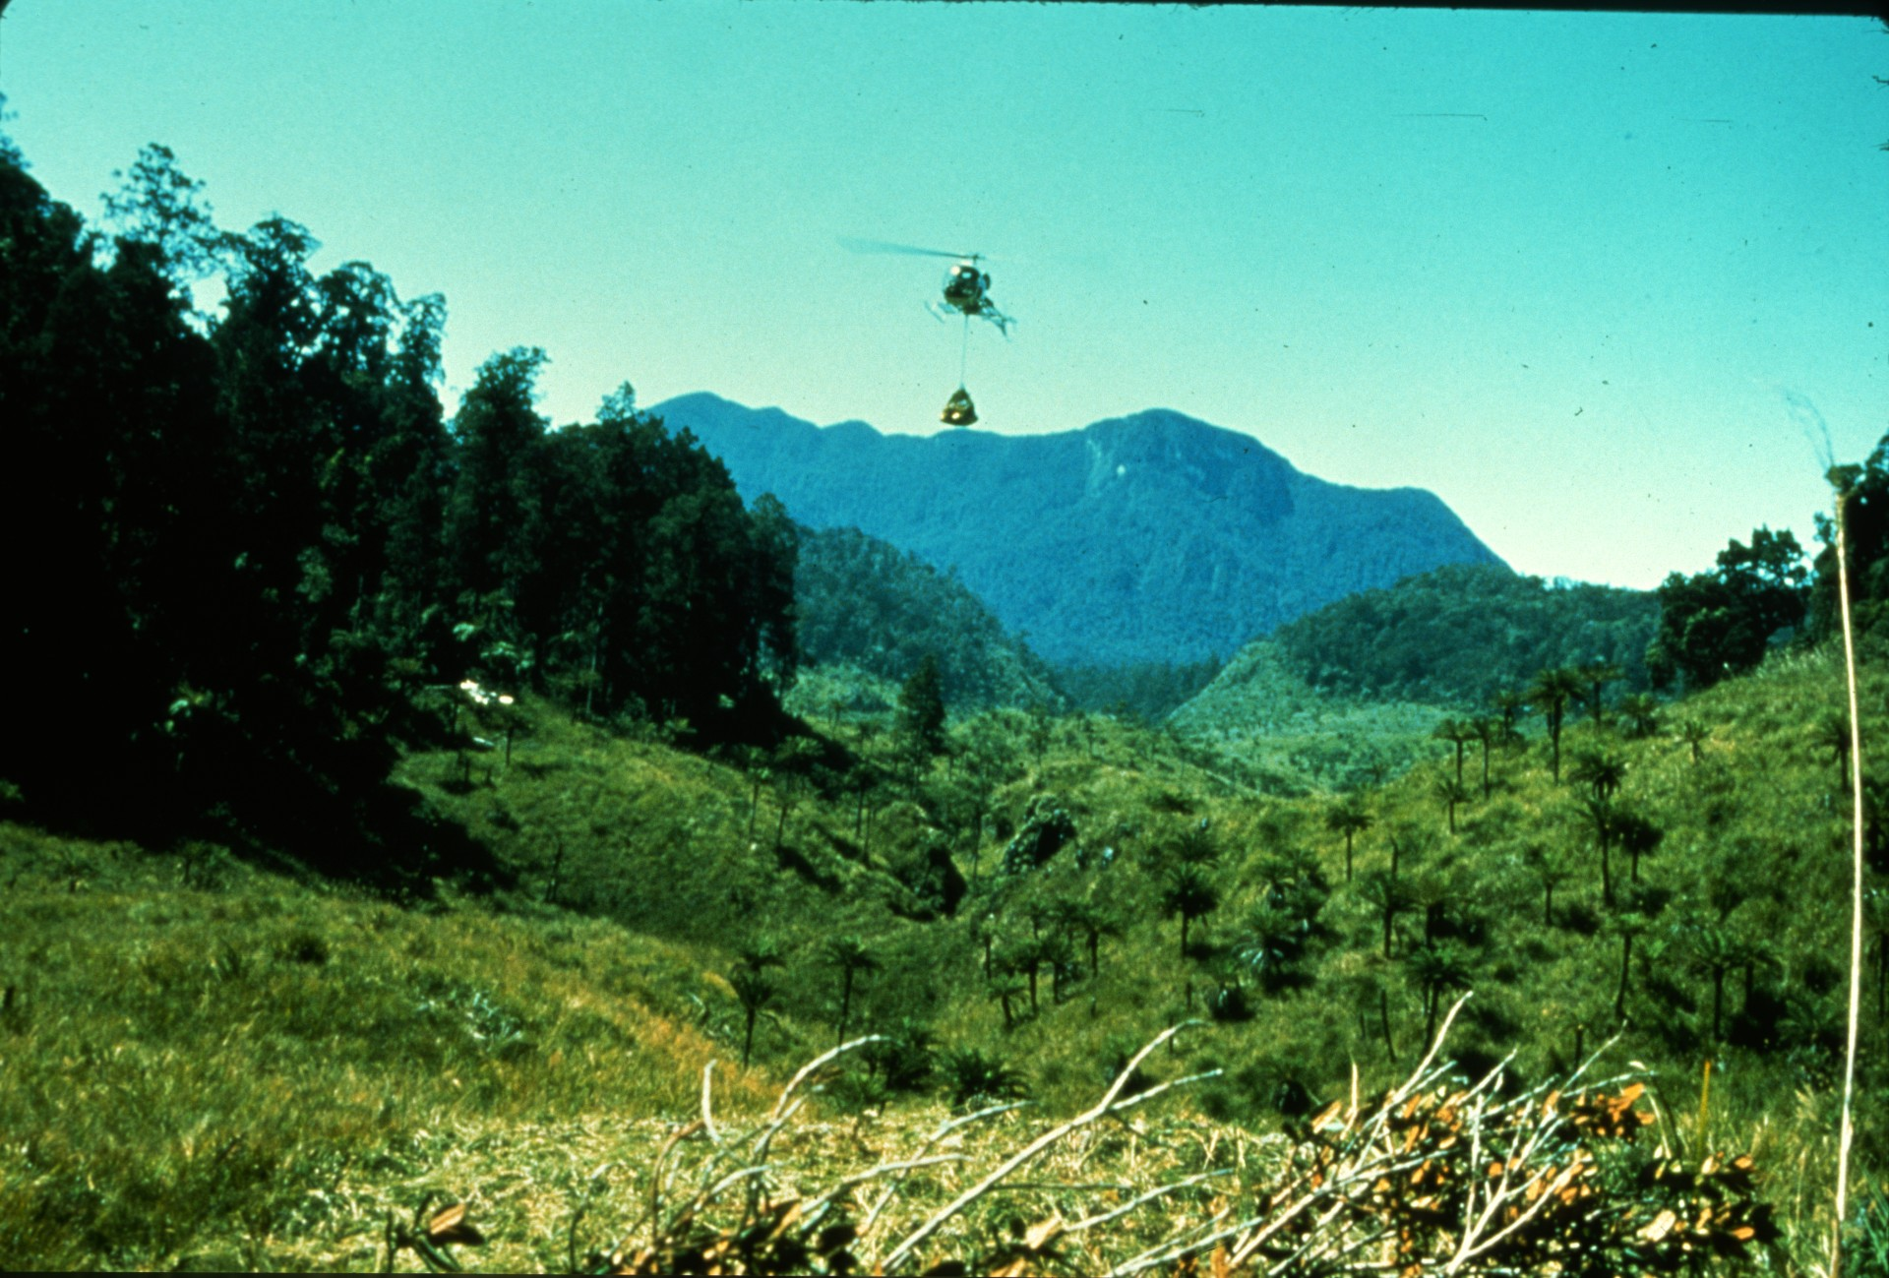
Notes:
While heavy supplies were brought in by chopper...

Slide 19
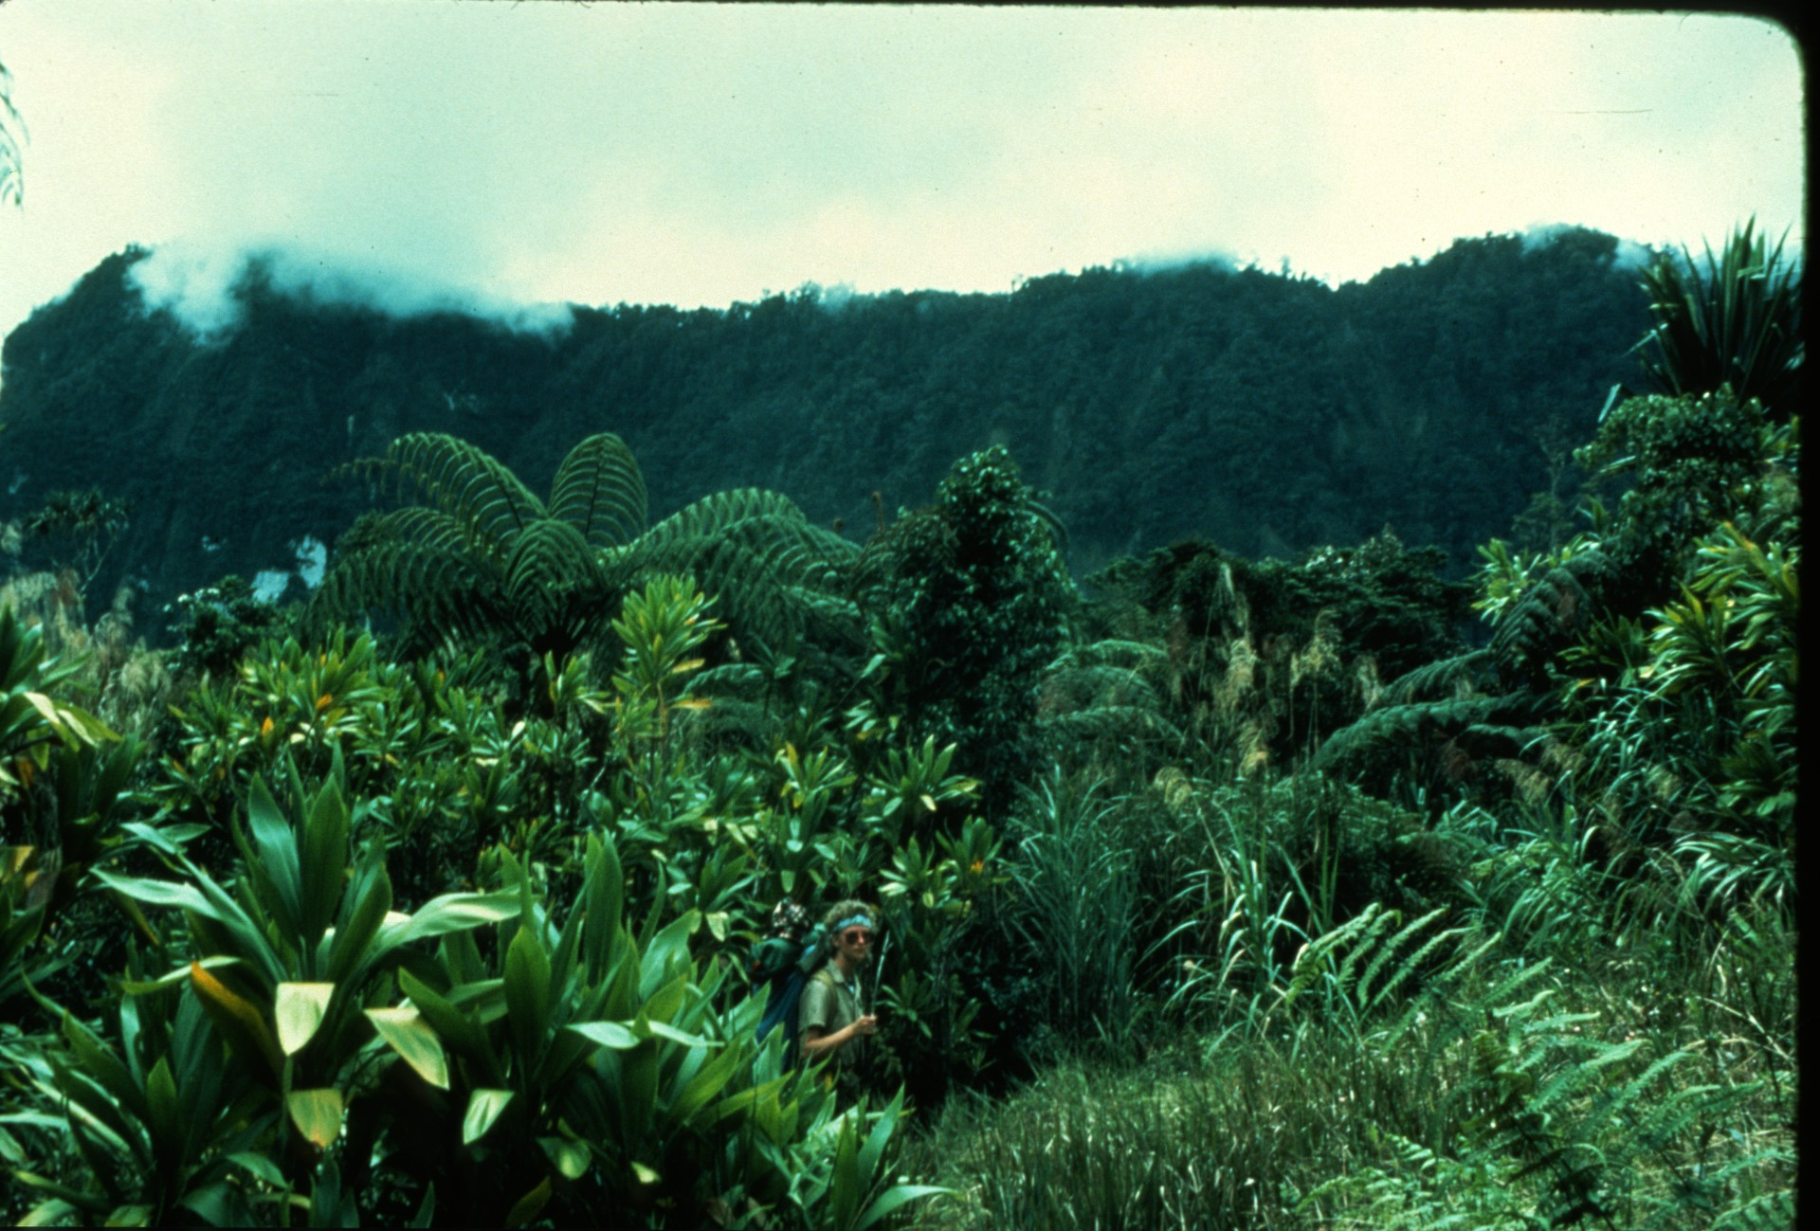
Notes:
The team began their trek through the jungle...

Slide 20
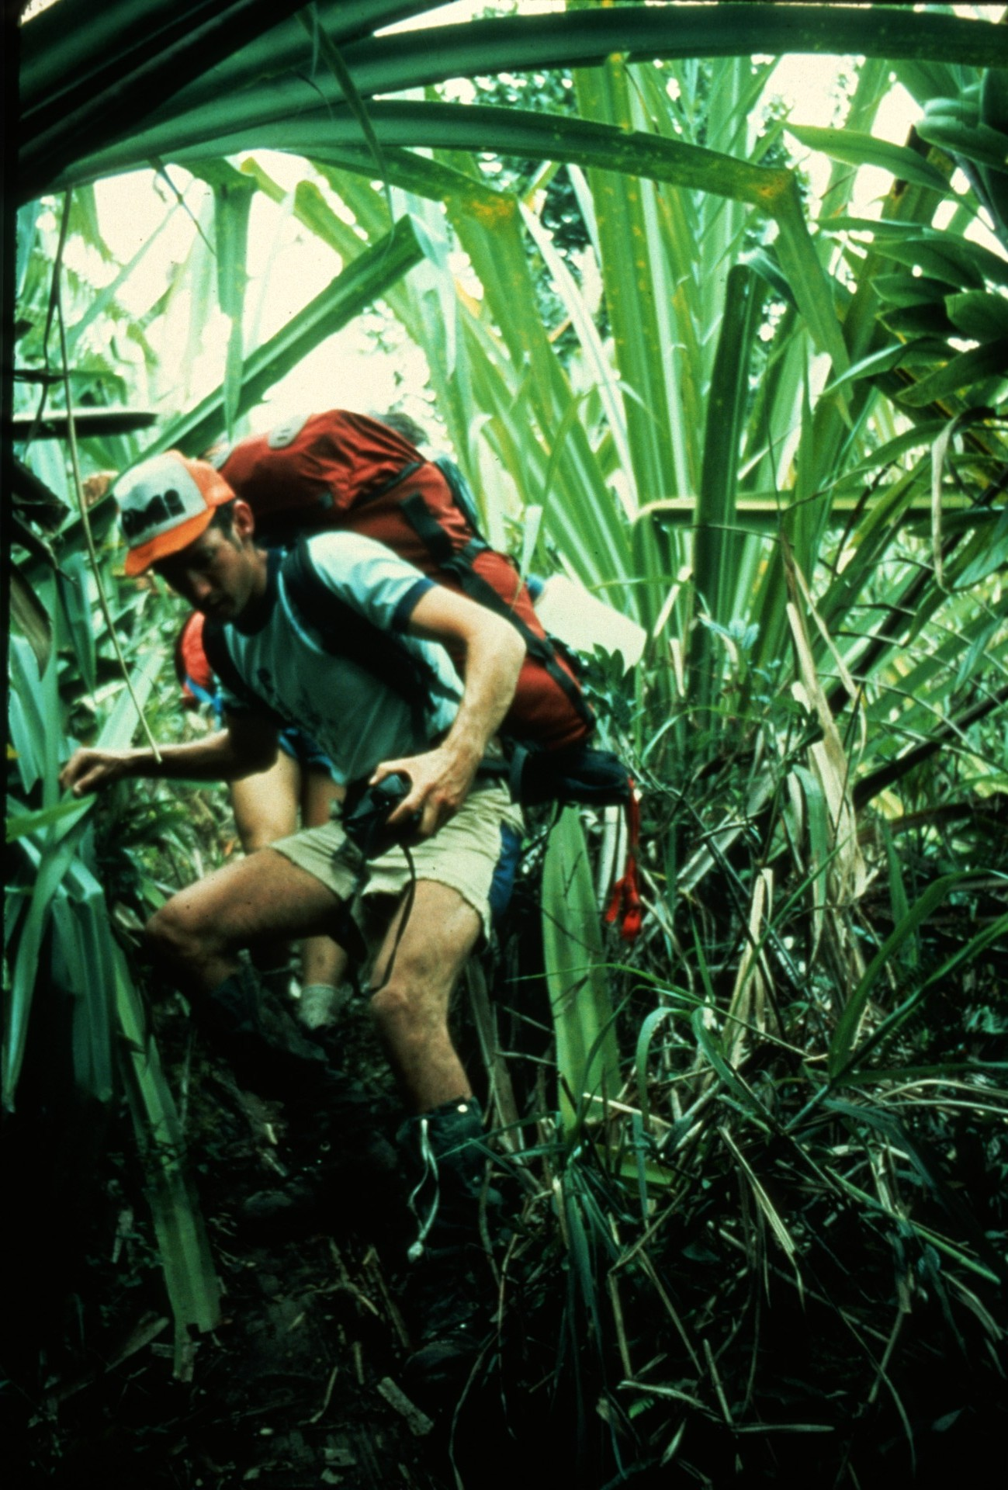
Notes:
carrying heavy loads along slippery trails.

Slide 21
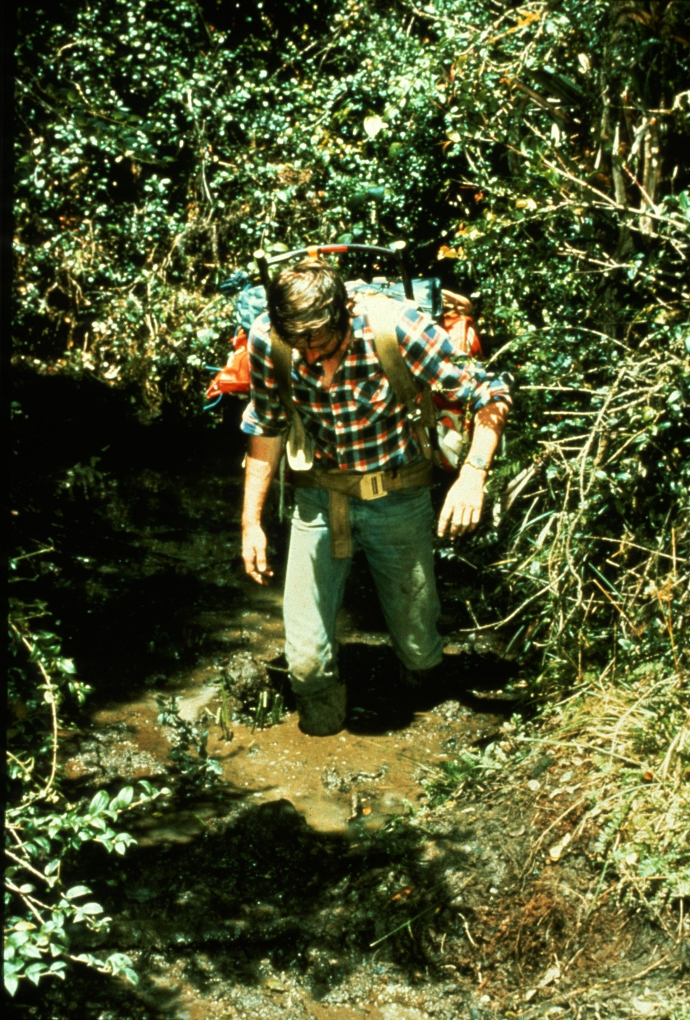
Notes:
Slogging through knee-deep mud...

Slide 22
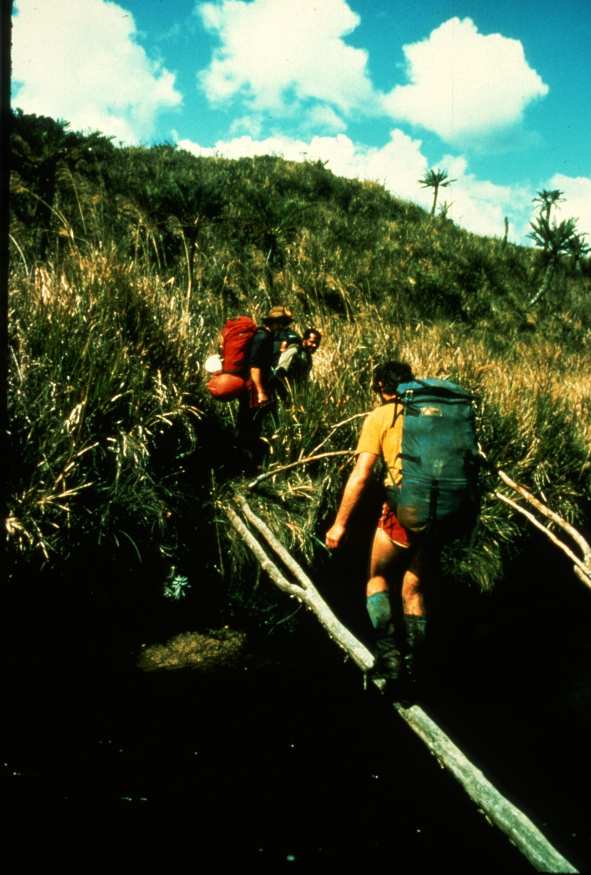
Notes:
crossing rivers on narrow logs...

Slide 23
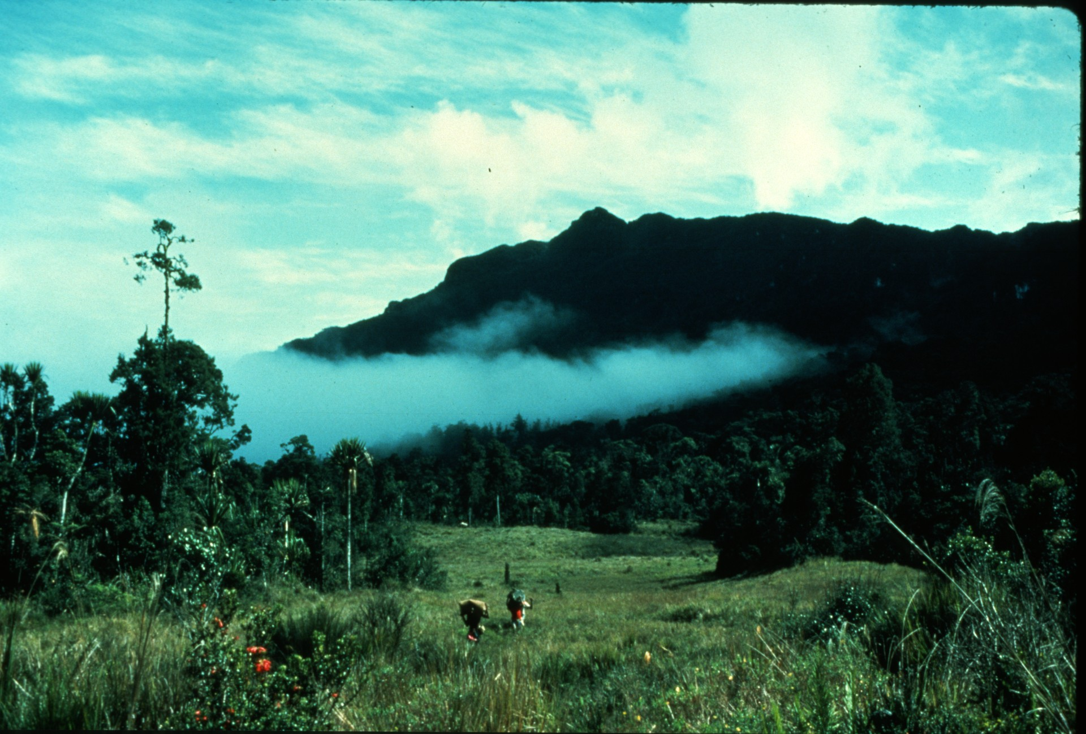
Notes:
brought the team to the large meadows at the base of Mt. Kaijende.

Slide 24
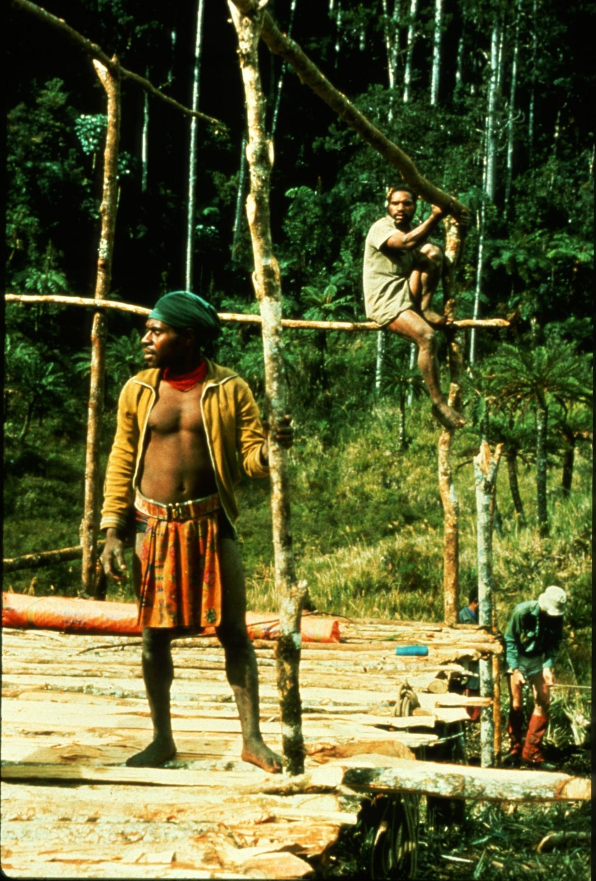
Notes:
With the help of ax-wielding natives trees were cut,

Slide 25
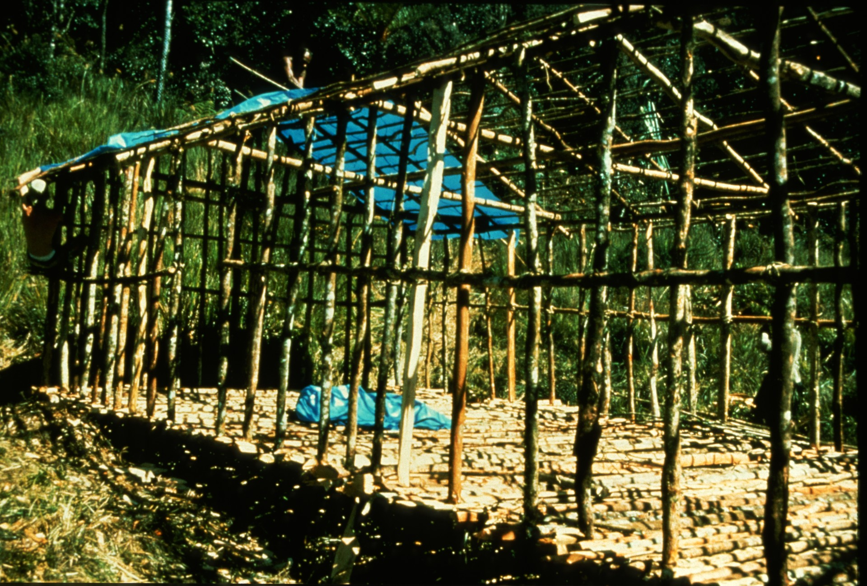
Notes:
lashed together with vines...

Slide 26
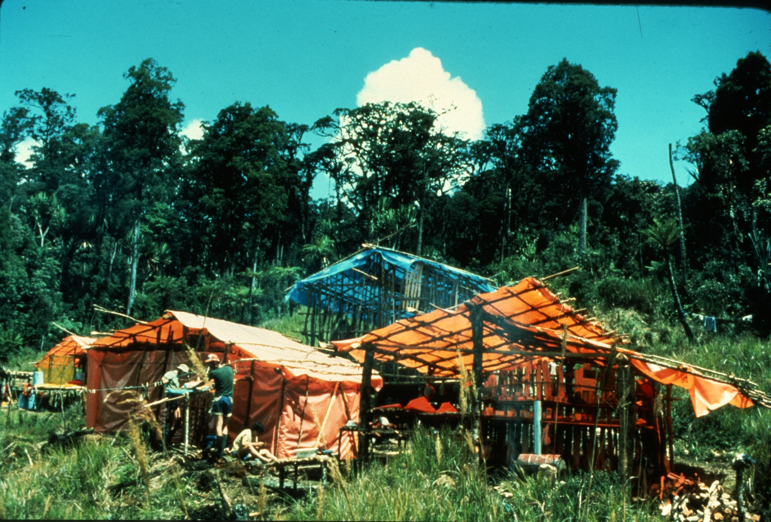
Notes:
and covered with plastic tarps to provide shelter from the heavy rains.

Slide 27
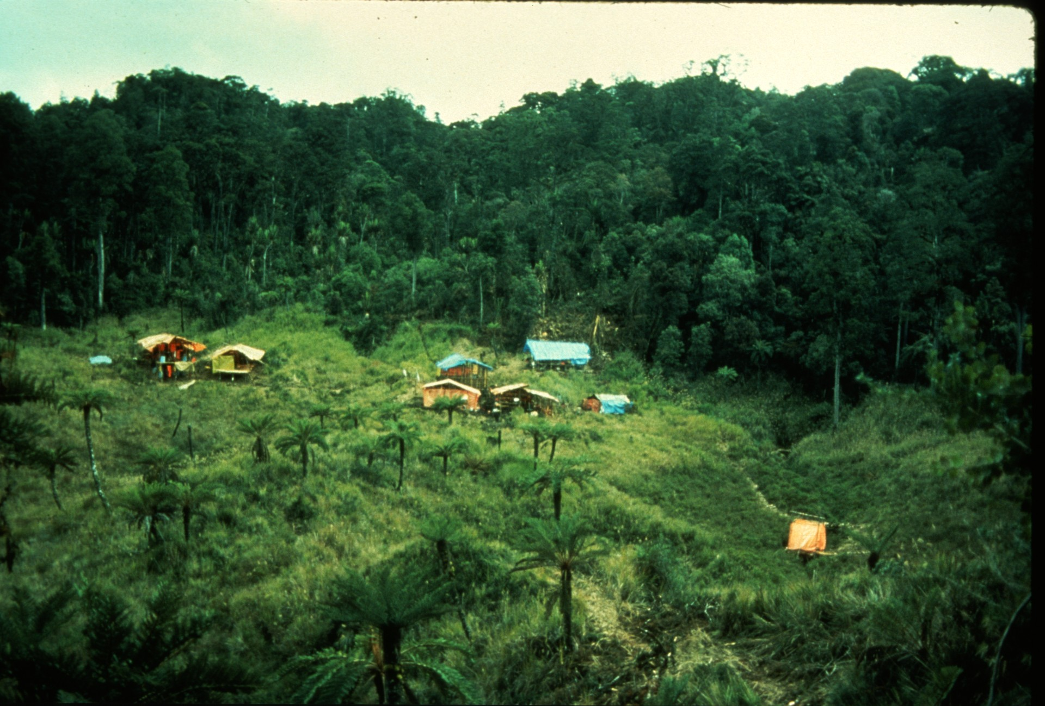
Notes:
The completed camp had 3 sleeping huts, a storeroom, a kitchen, and even a shower. A small spring provided water.

Slide 28
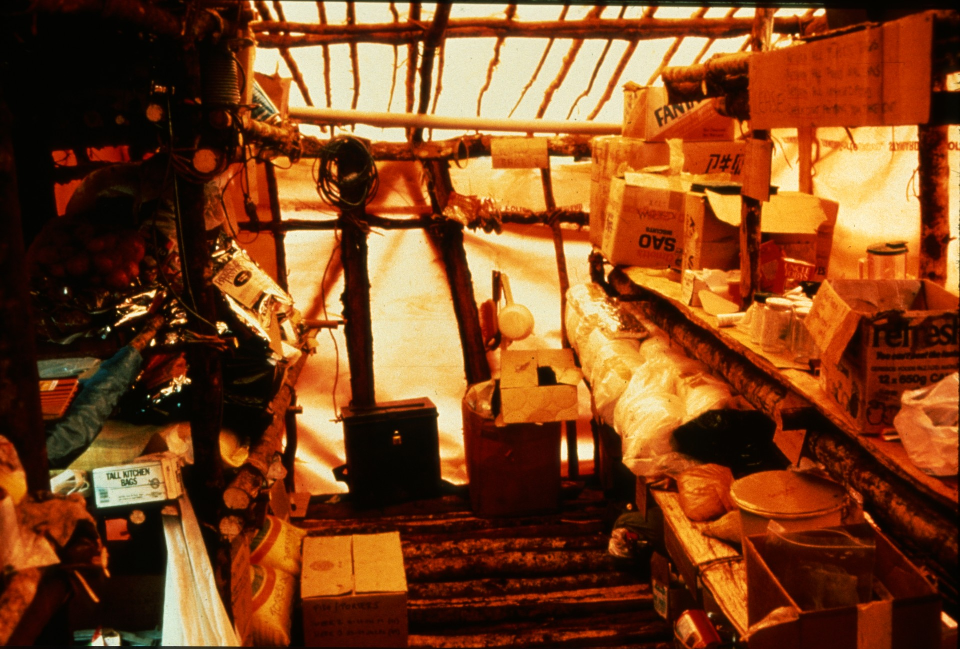
Notes:
Food, primarily fish, rice, and corned beef, was partitioned into weekly rations so as to last the
full two months.

Slide 29
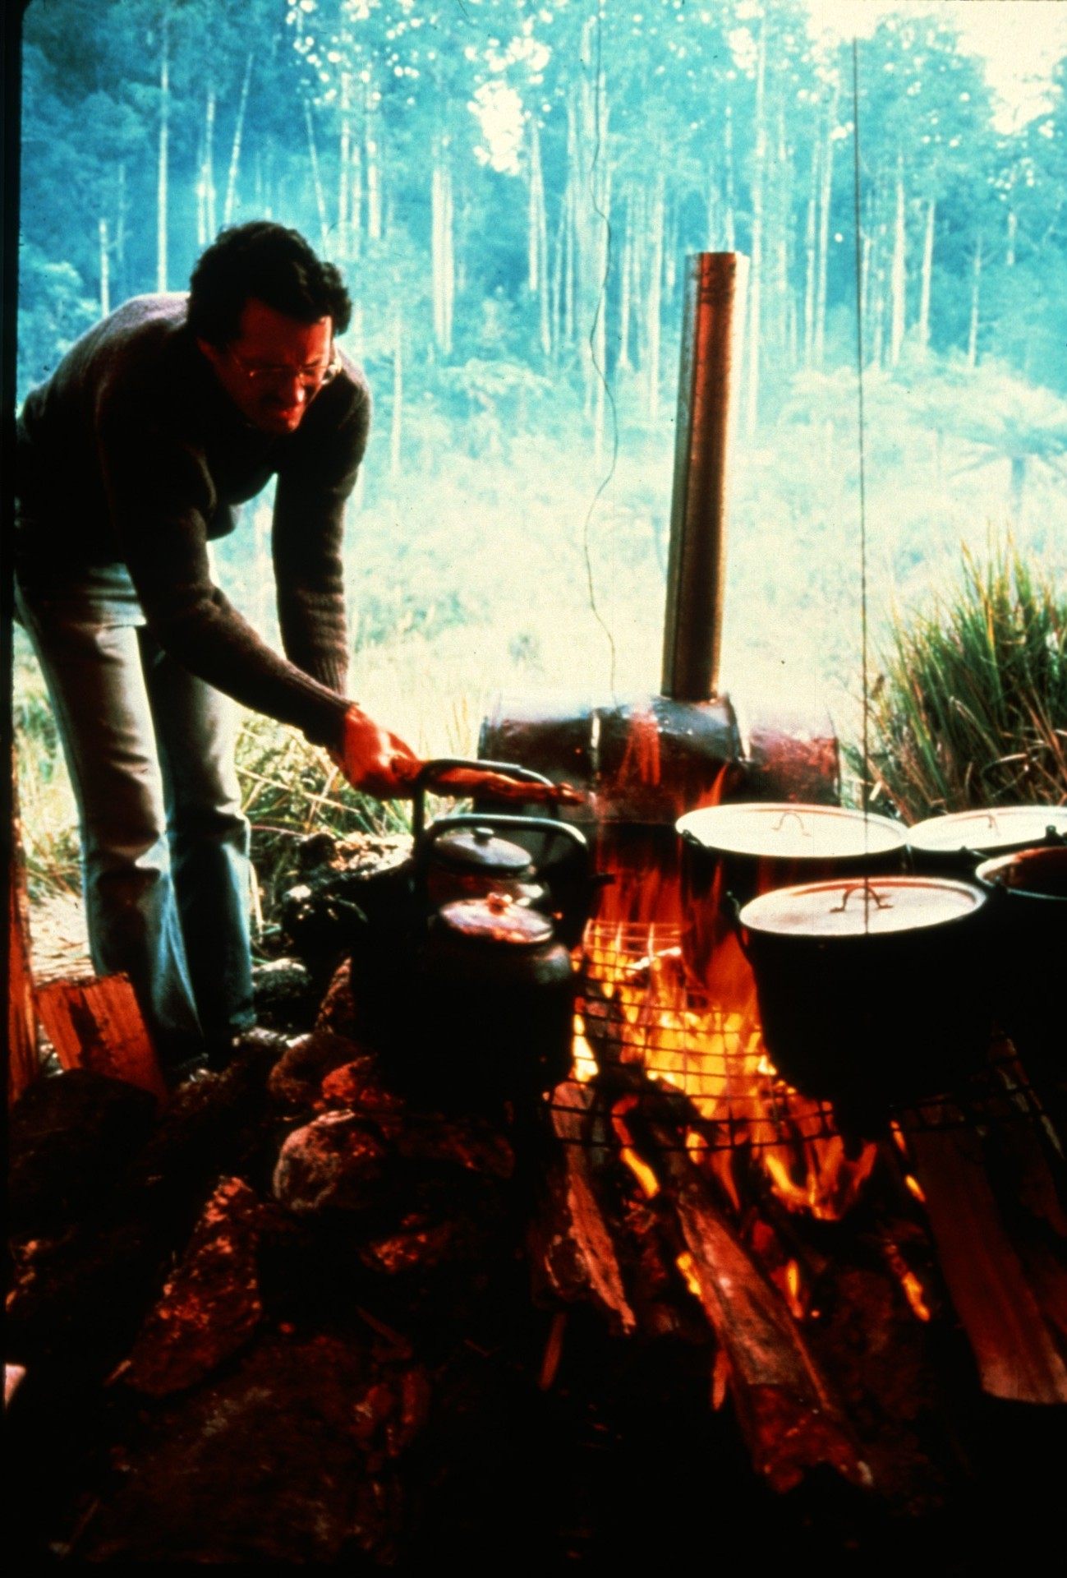
Notes:
Cooking in basecamps and fieldcamps was done on wood fires.

Slide 30
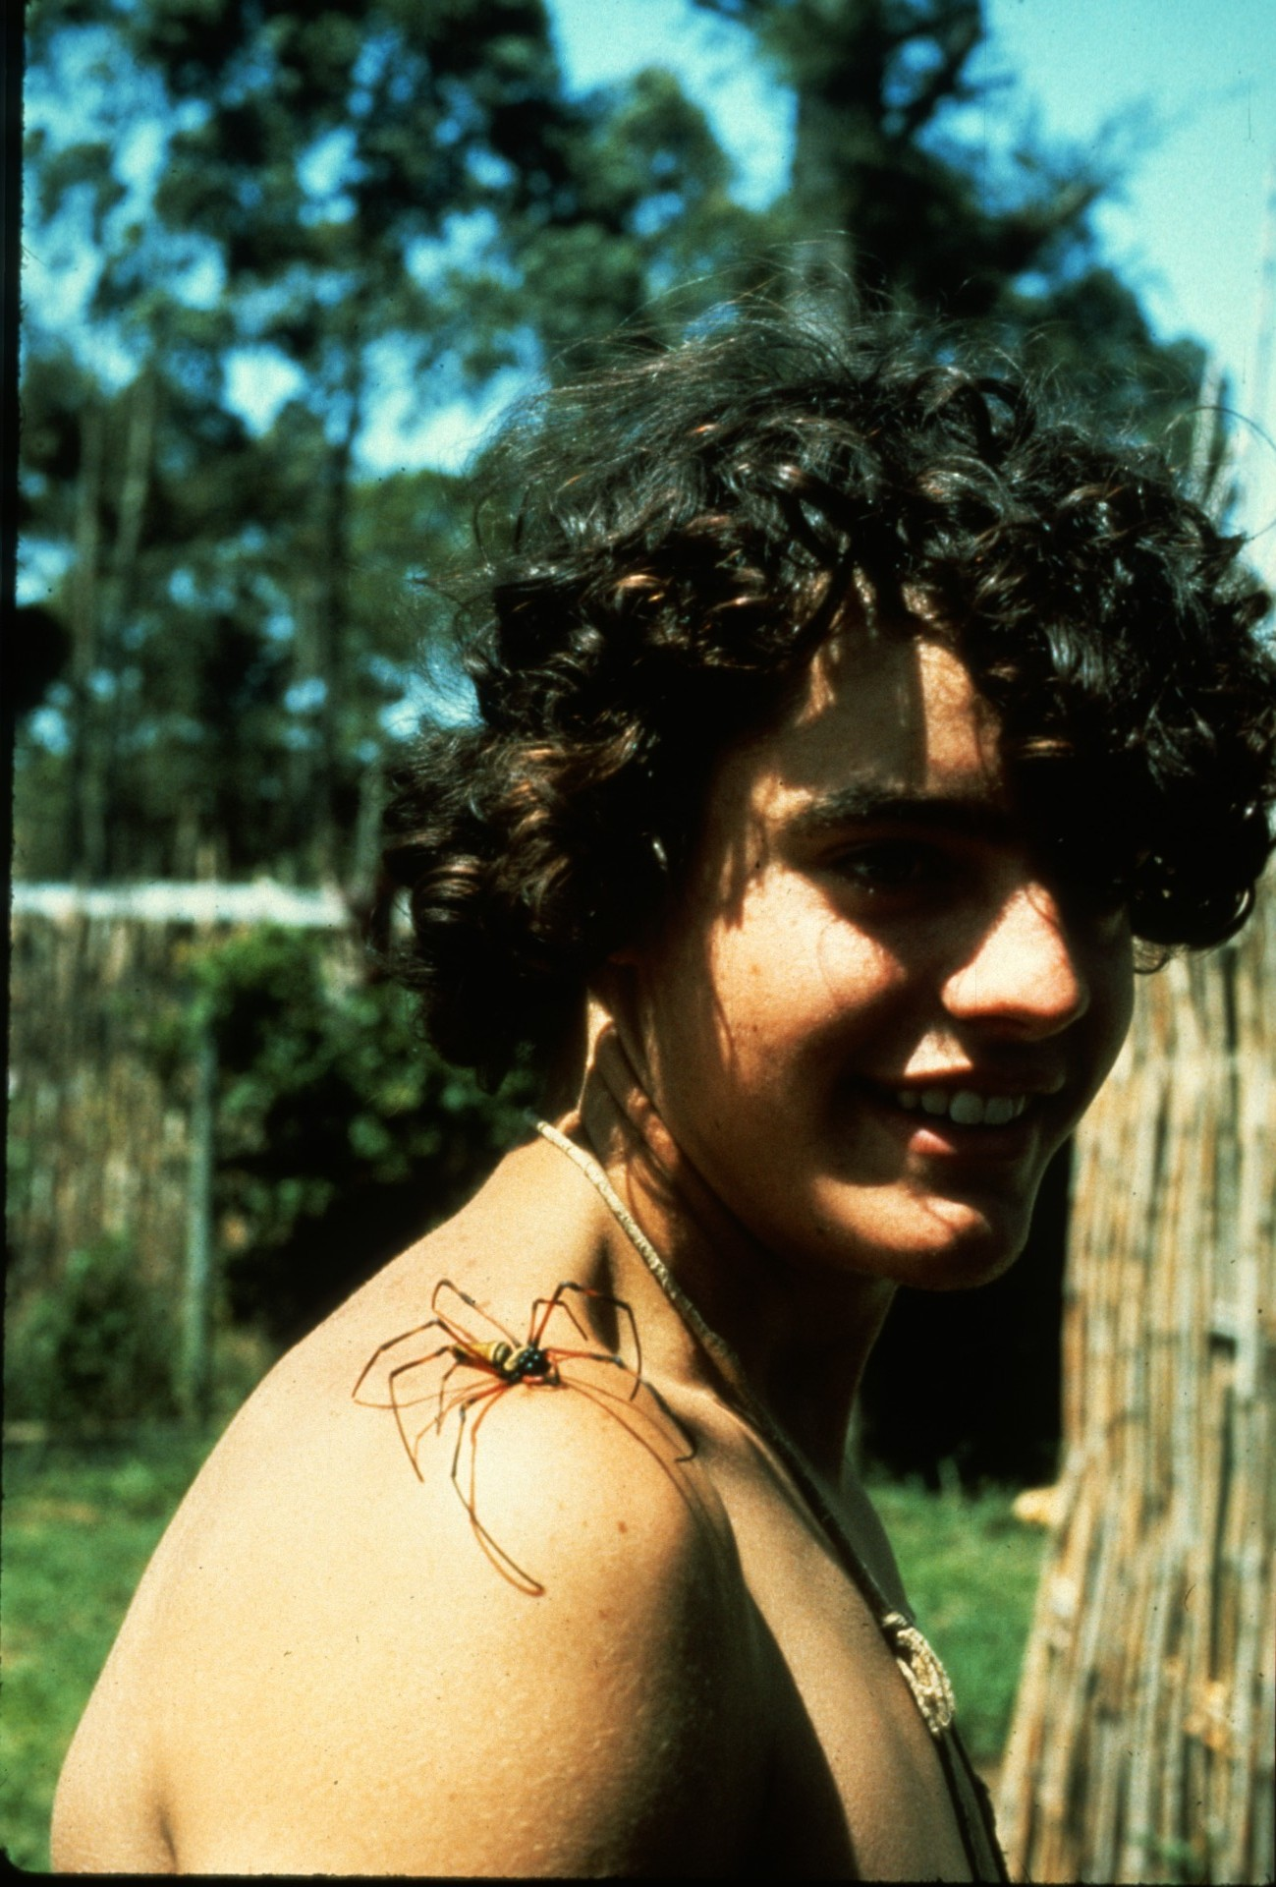
Notes:
The surrounding jungles brought in unusual insect visitors...

Slide 31
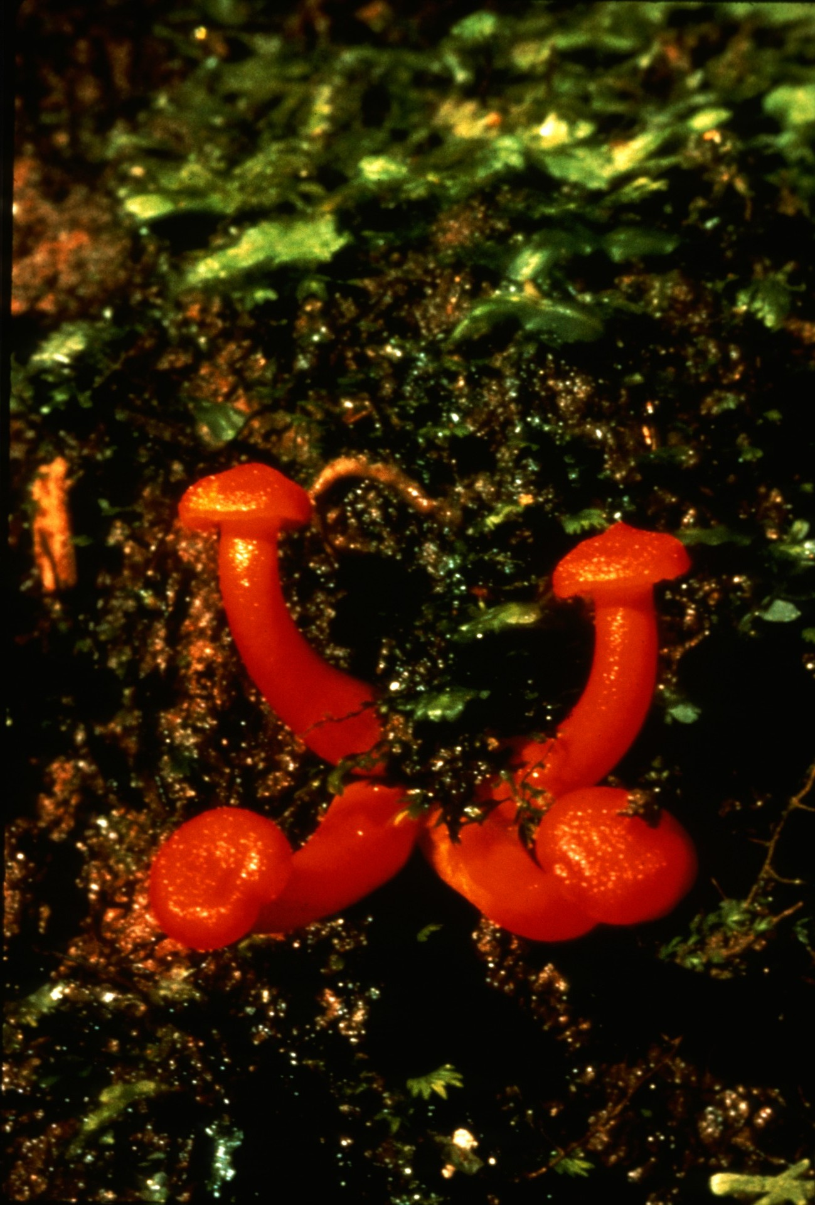
Notes:
and contained beautiful mushrooms...

Slide 32
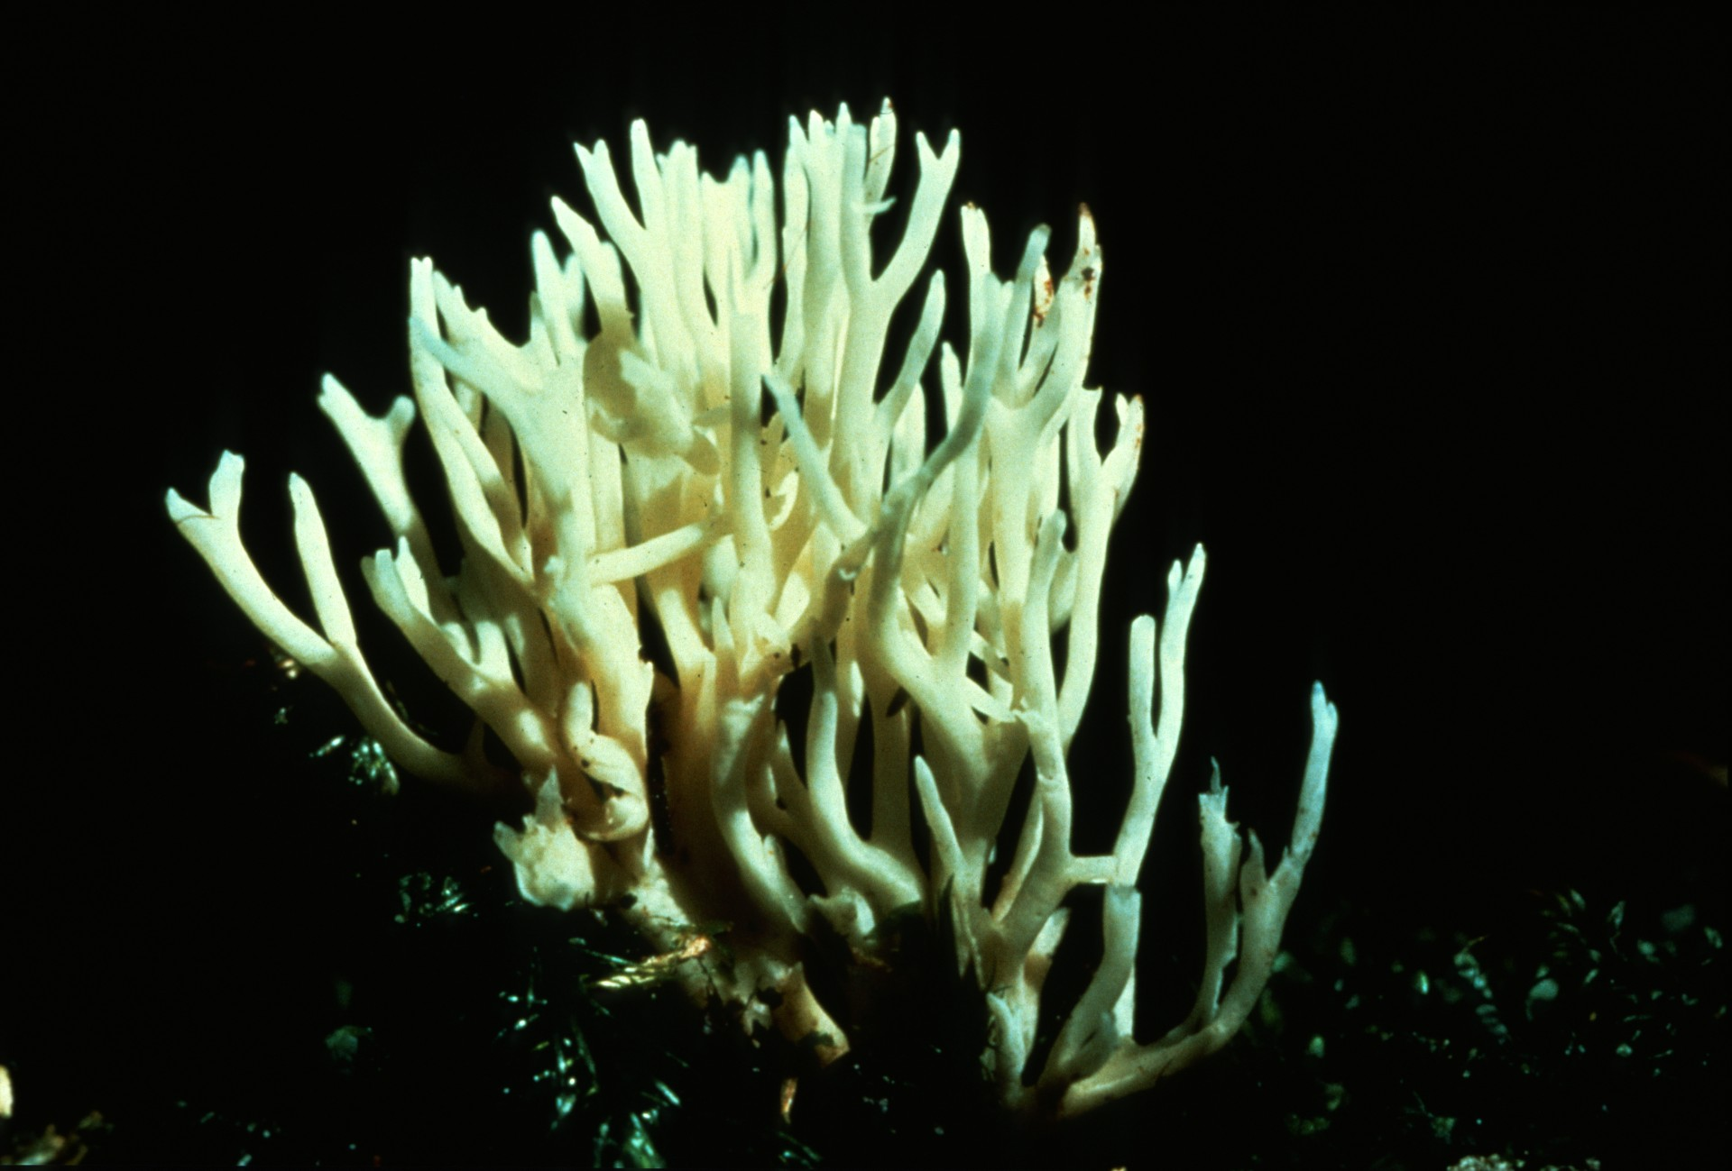
Notes:
and fungi such as this coral mushroom.

Slide 33
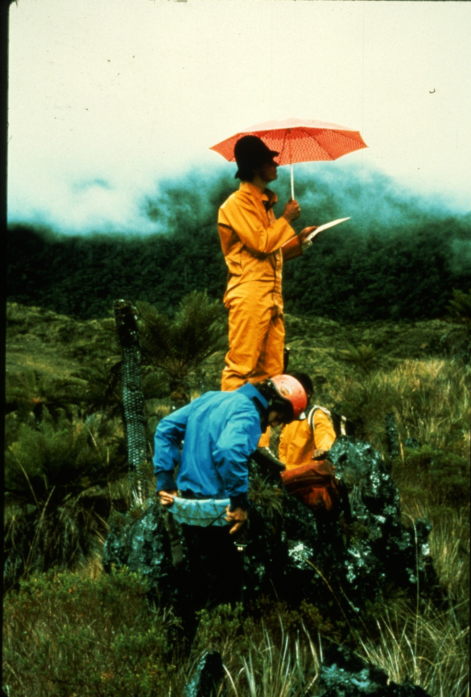
Notes:
The search for caves was not discouraged by the daily rains.

Slide 34
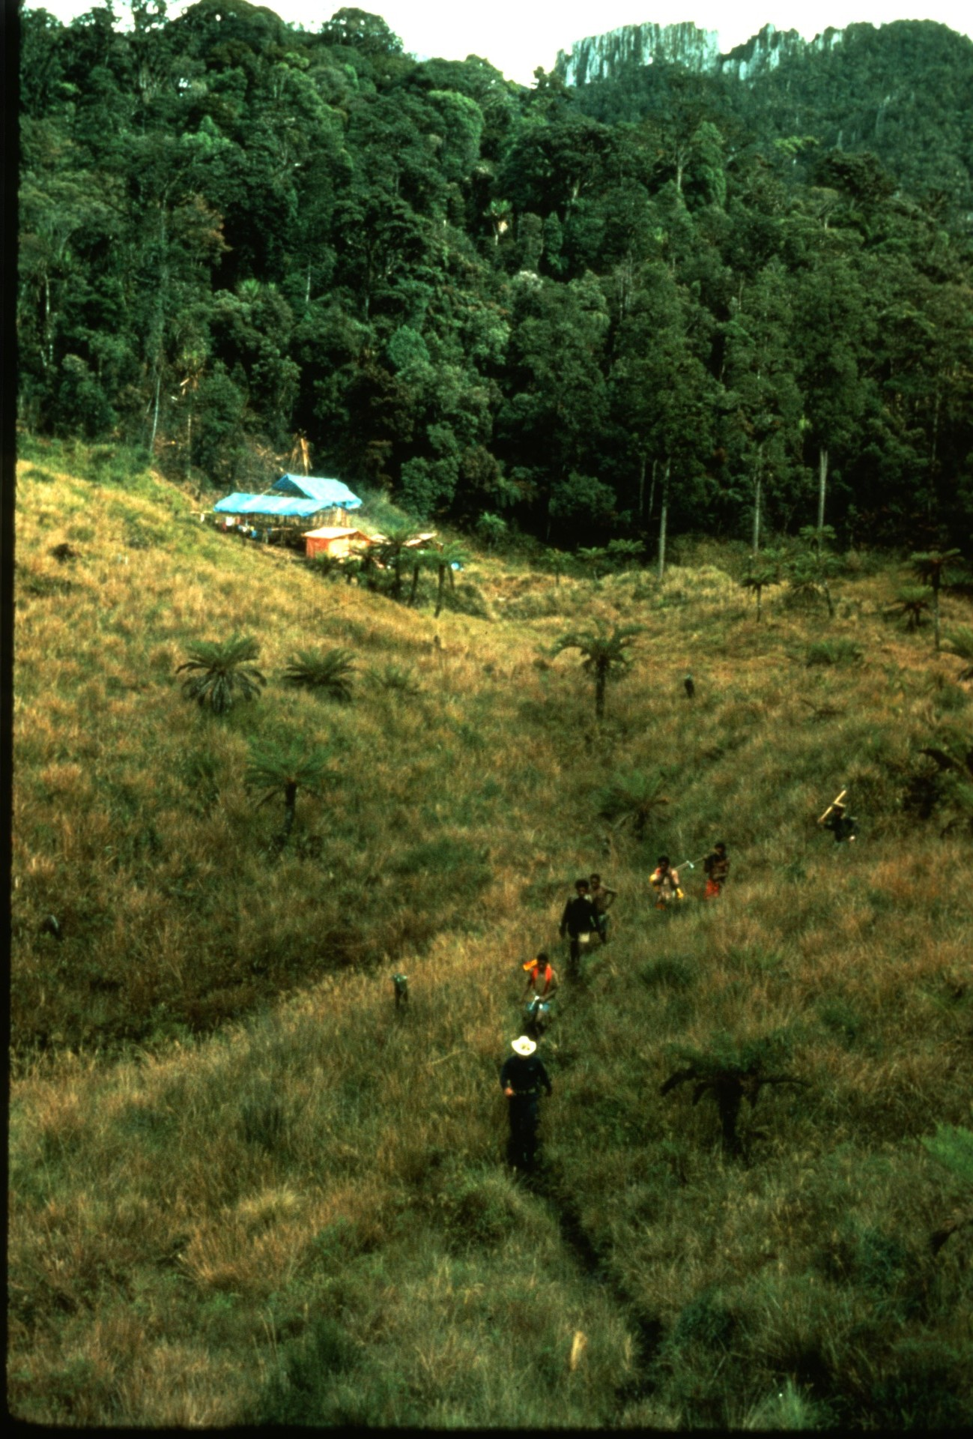
Notes:
Multi-day trips set out from basecamp with several porters who carried canned food, chopped the trail, and cut firewood for cooking.

Slide 35
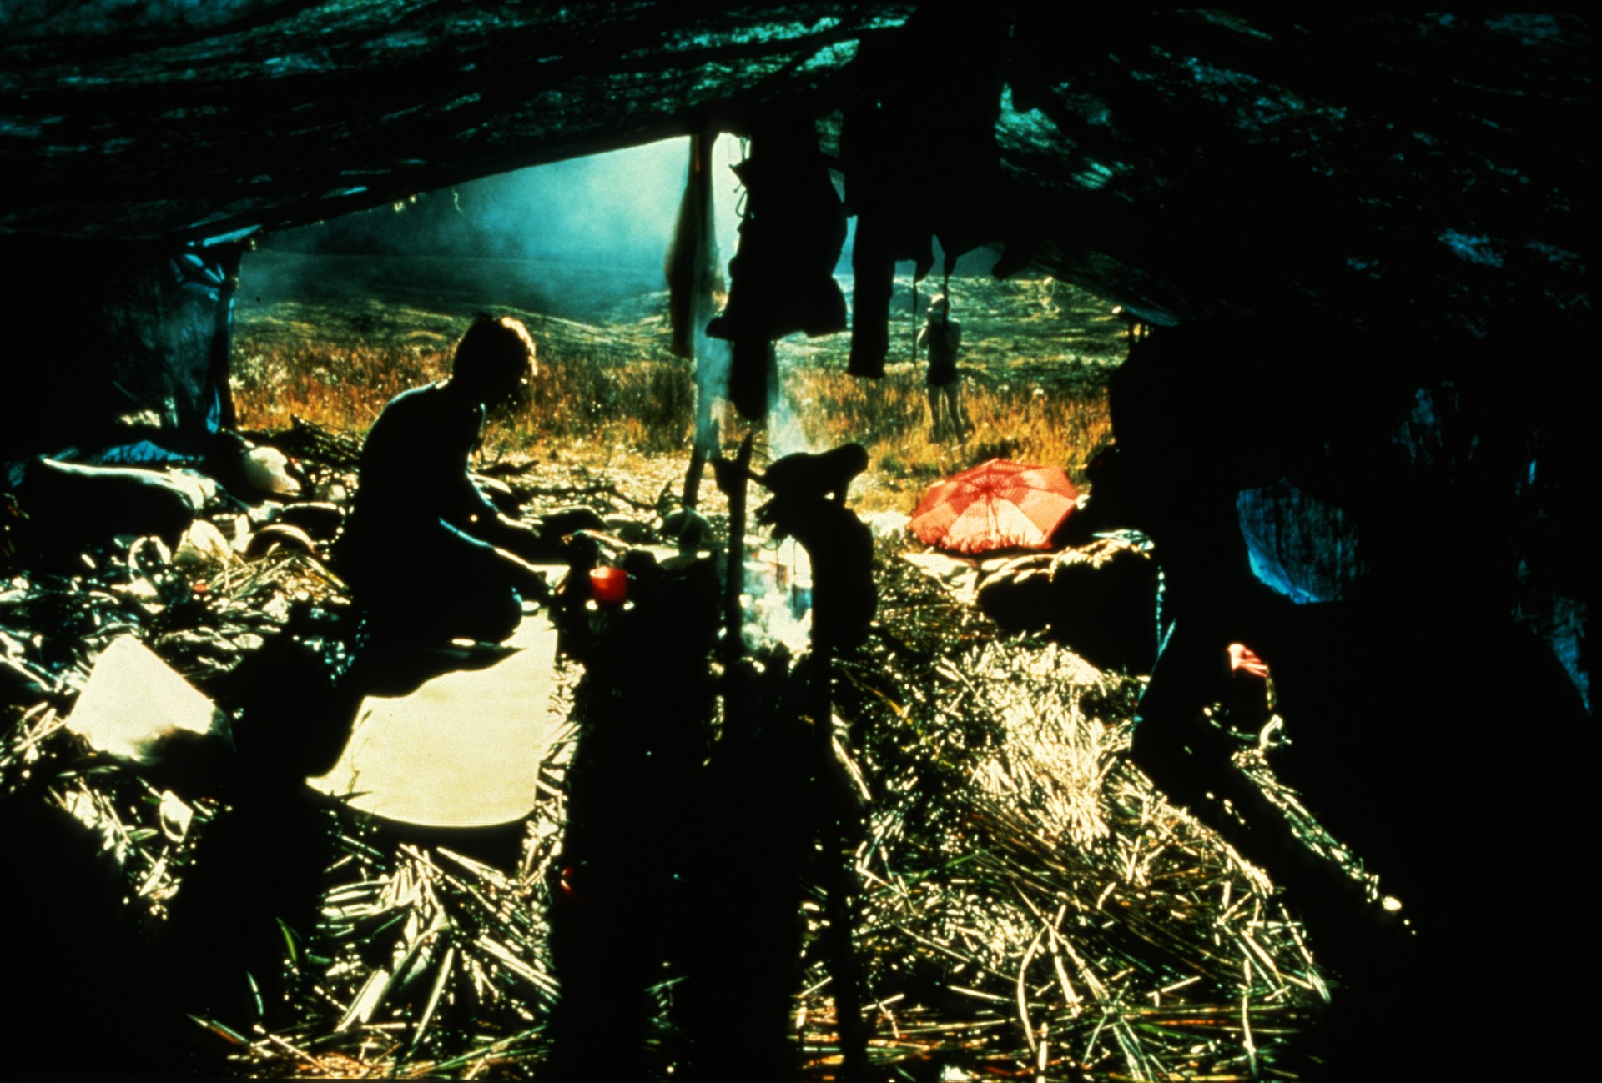
Notes:
Small fieldcamps were constructed with native help.

Slide 36
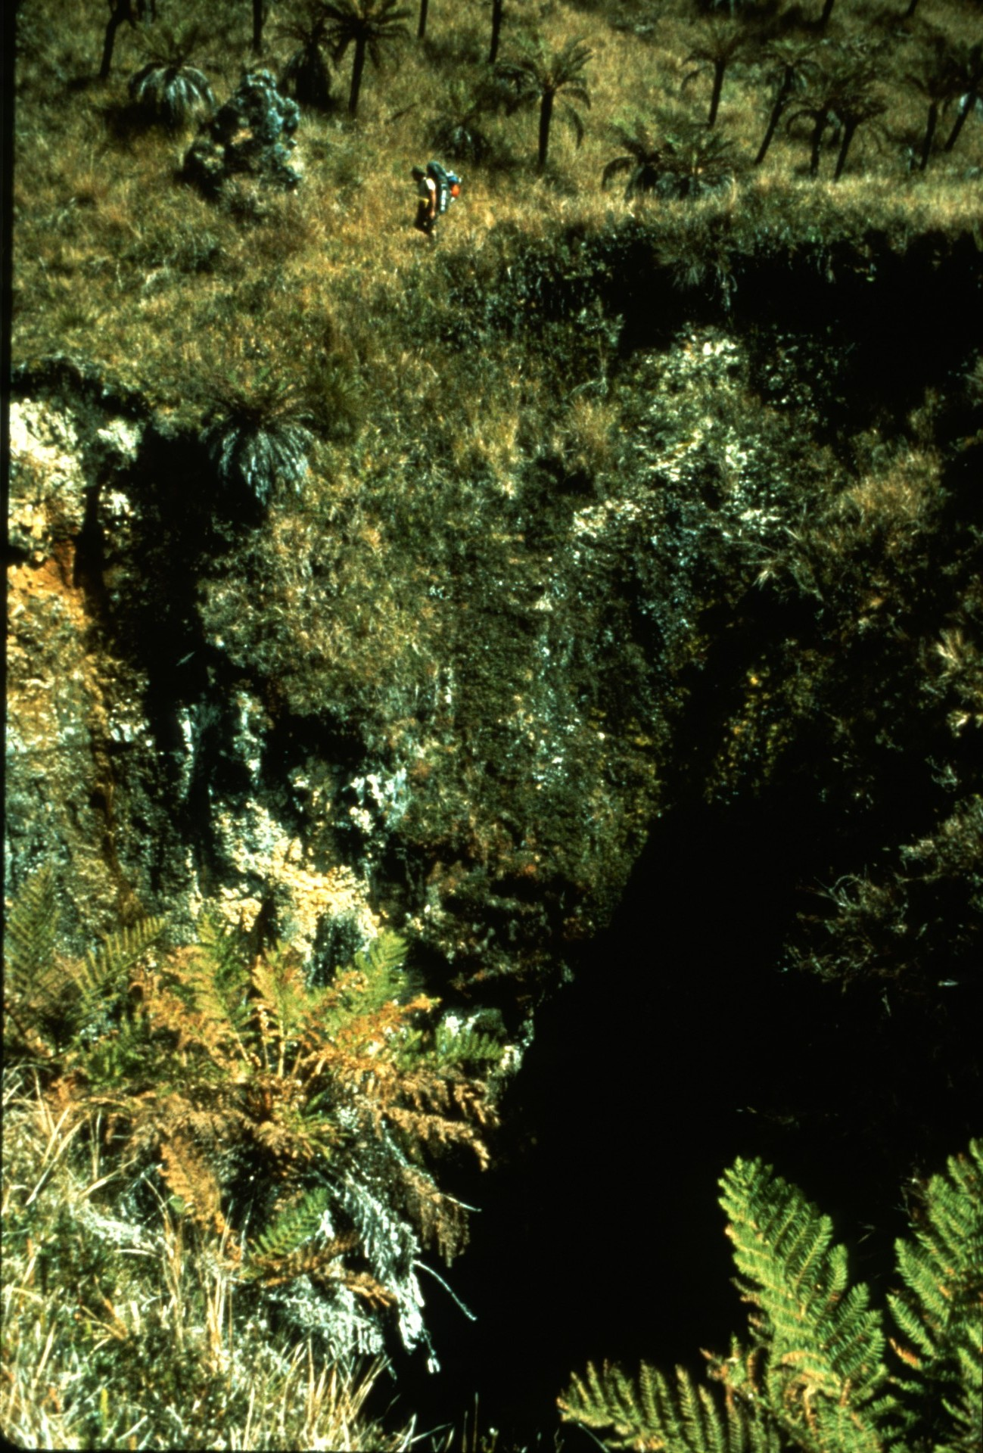
Notes:
Early finds were disappointing: blind pits...

Slide 37
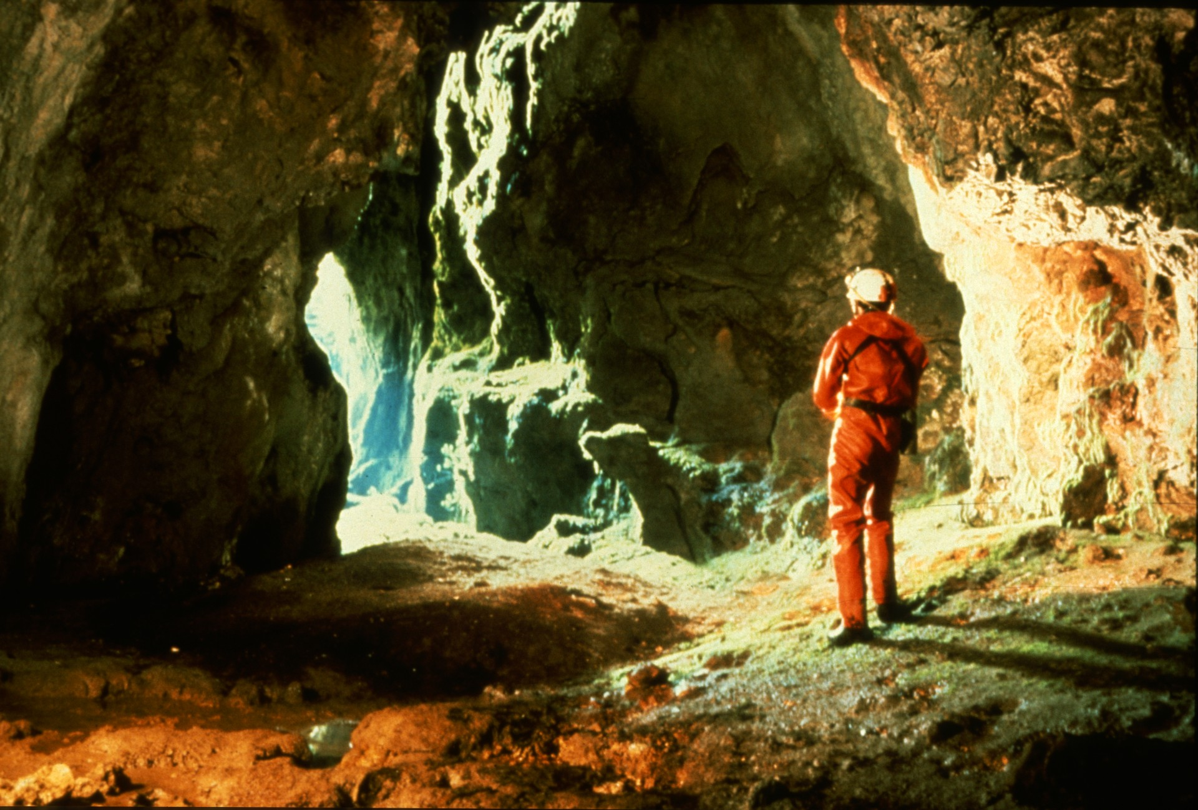
Notes:
and small but scenic shelters.

Slide 38
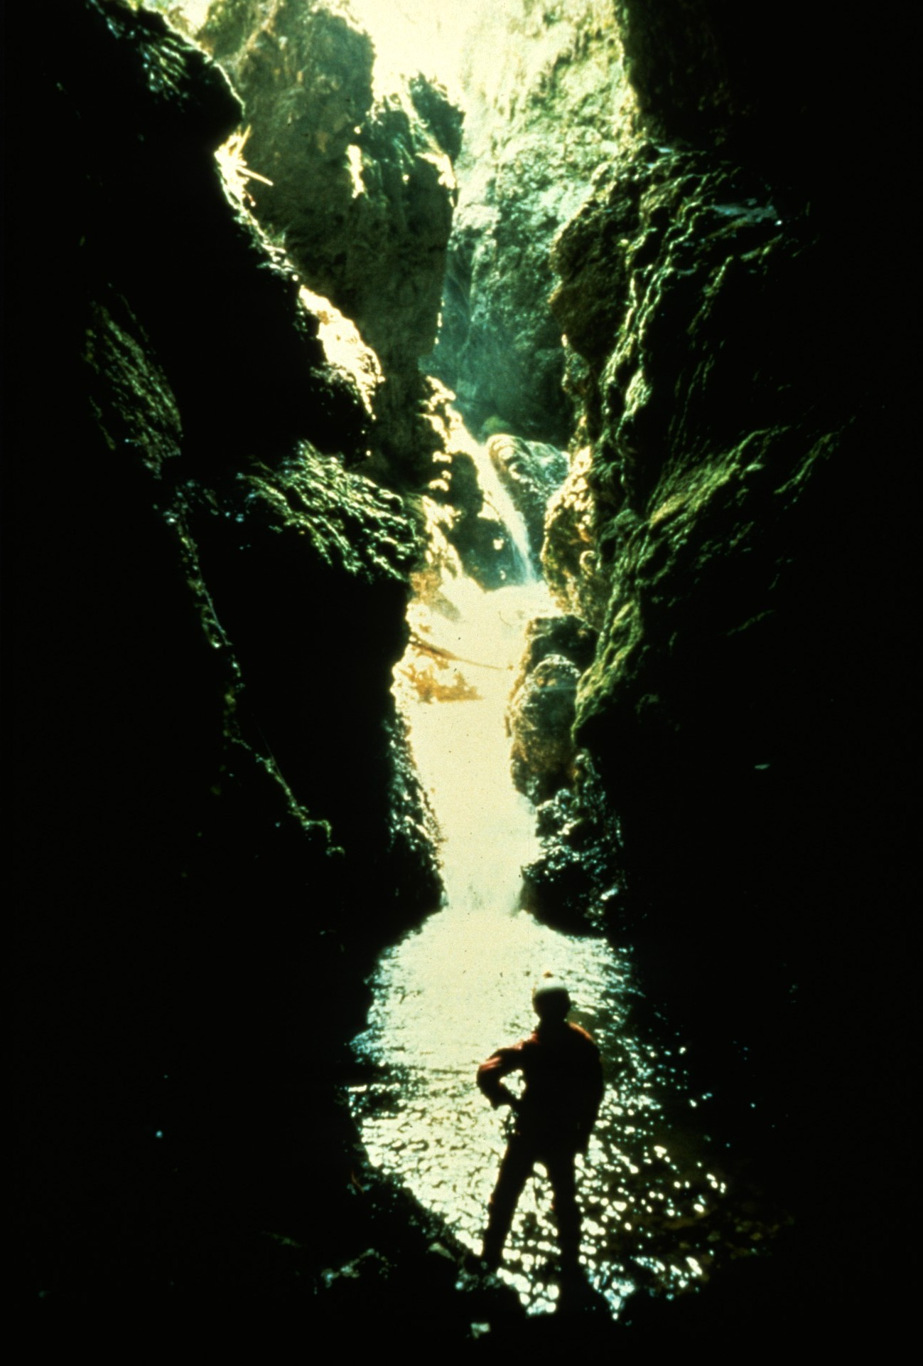
Notes:
The first significant cave was located by following a sinking stream shown on an aerial photo.

Slide 39
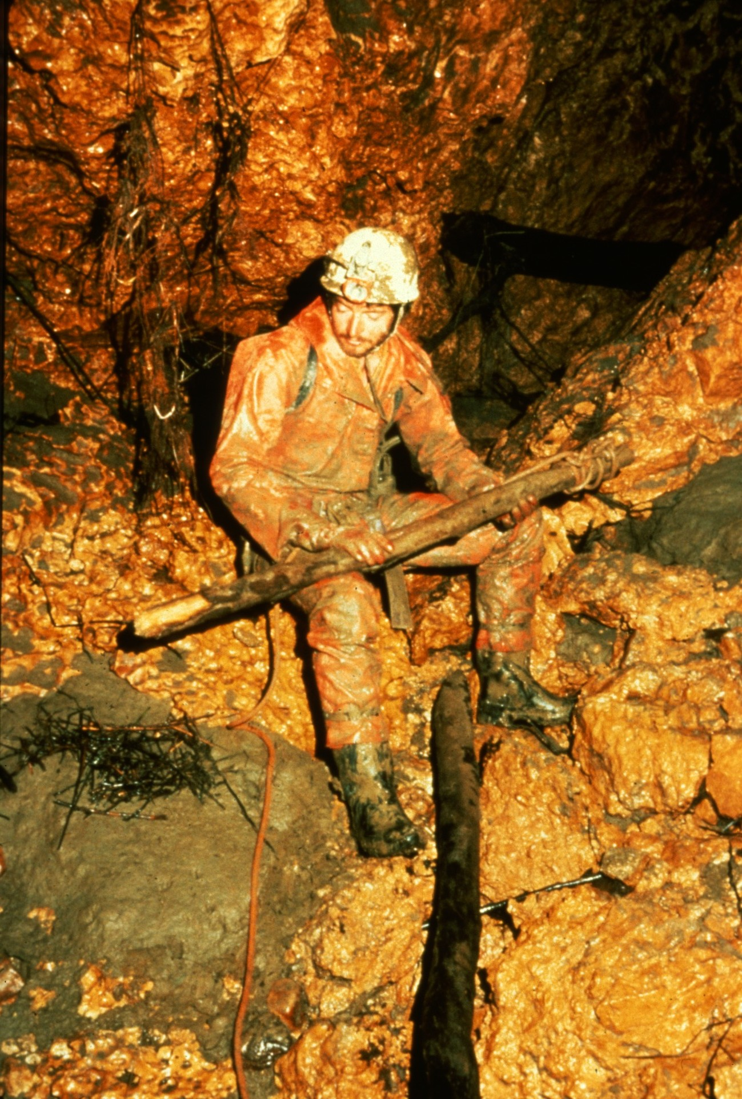
Notes:
Lack of a natural anchor forced the team to use a stick pushed into the mud for the 50' rappel at the entrance.

Slide 40
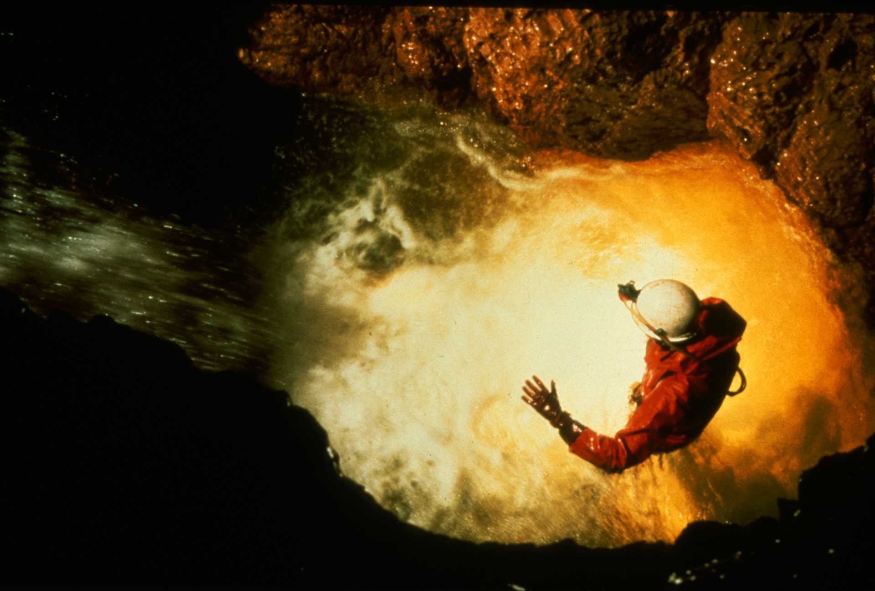
Notes:
Though only 250 meters was surveyed, it proved sporting and wet...

Slide 41
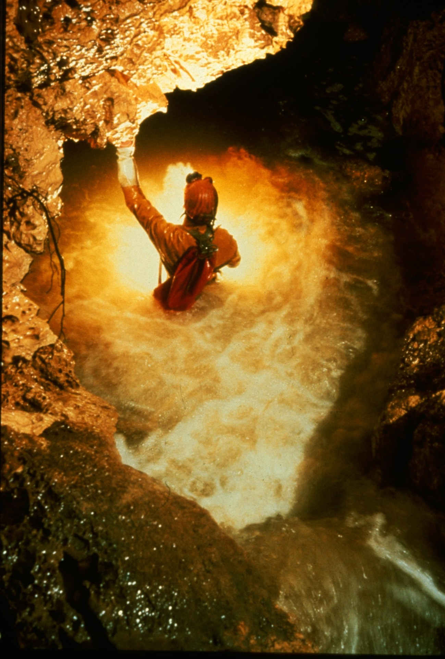
Notes:
with the danger of flooding ever present.

Slide 42
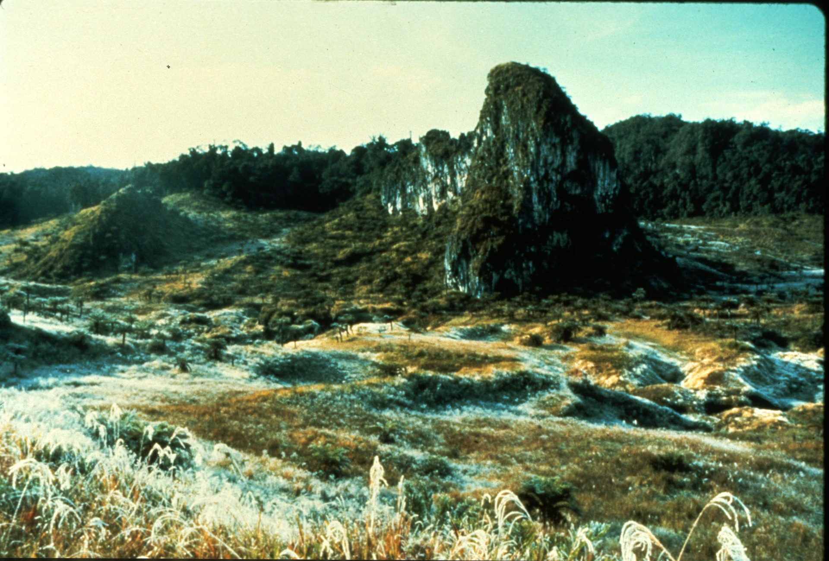
Notes:
Cavers on a reconnaissance trip to a distant clearing awoke to frost on a sinkhole plain.

Slide 43
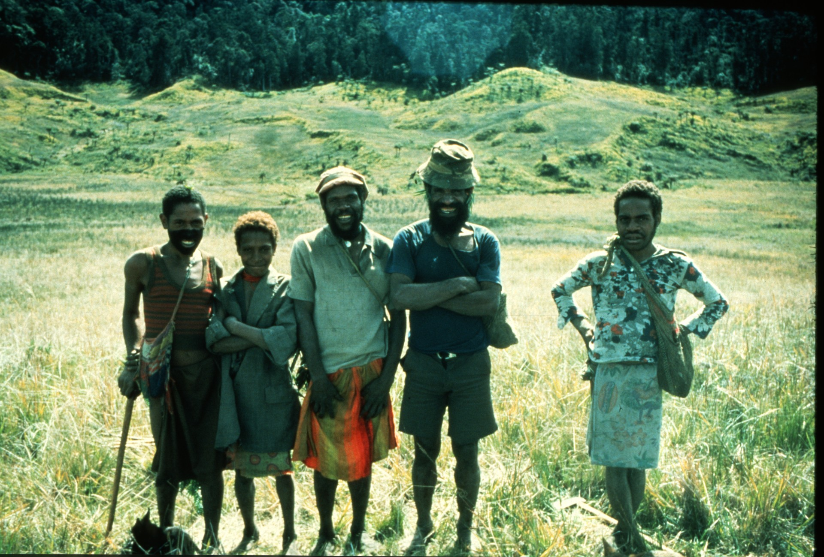
Notes:
The crew was greeted by a native hunting party..

Slide 44
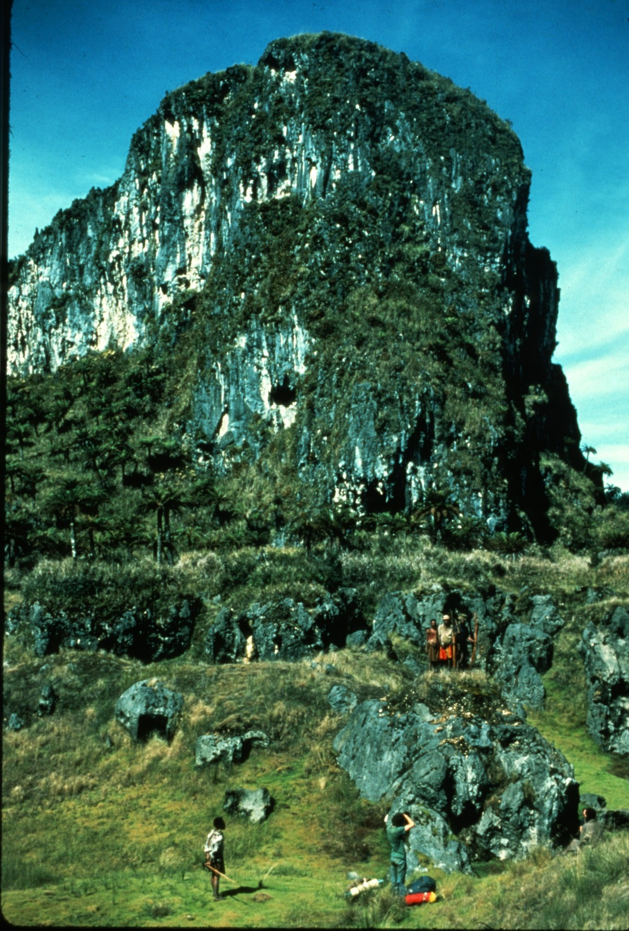
Notes:
who looked on while they searched the pinnacle for caves.

Slide 45
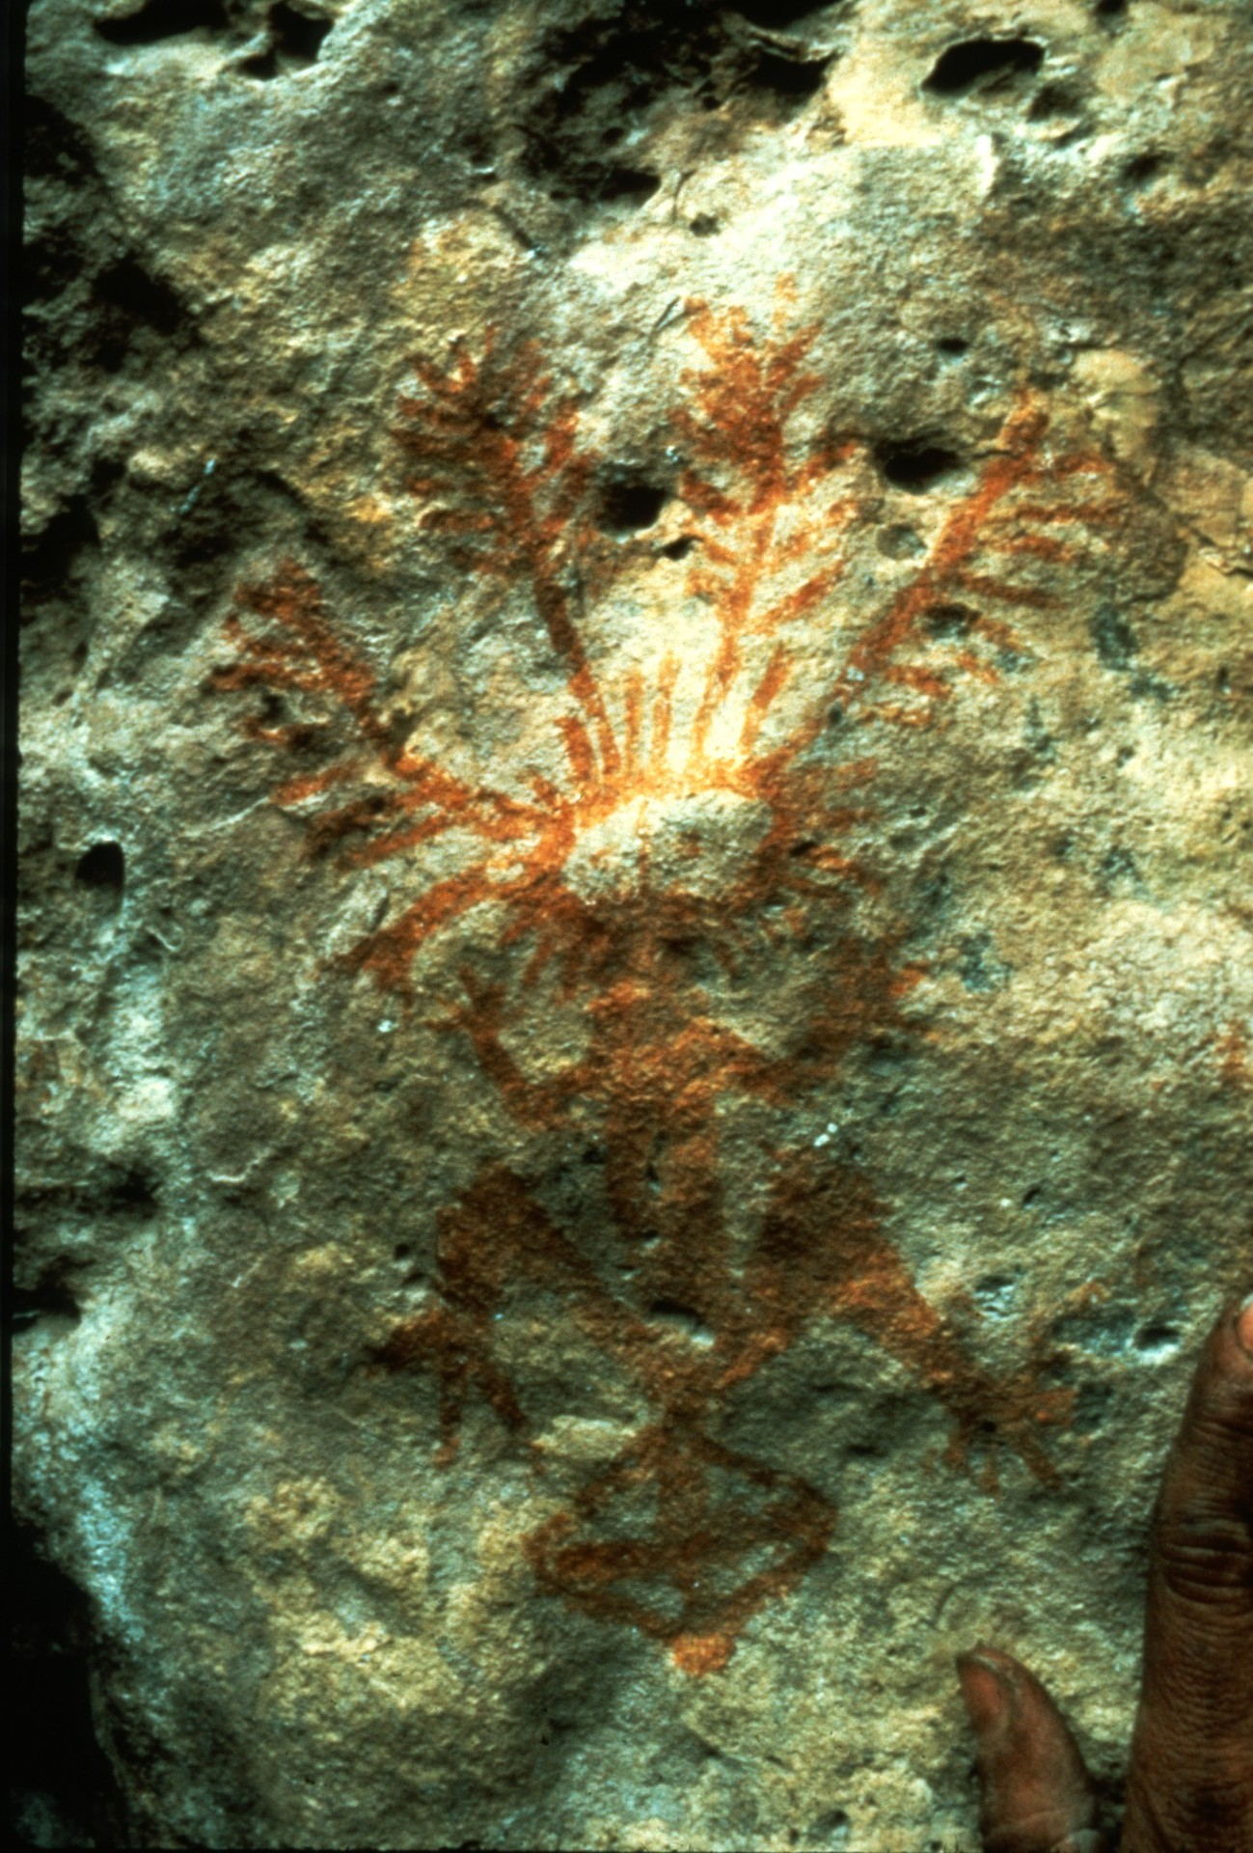
Notes:
A small shelter in the pinnacle yielded this pictograph.

Slide 46
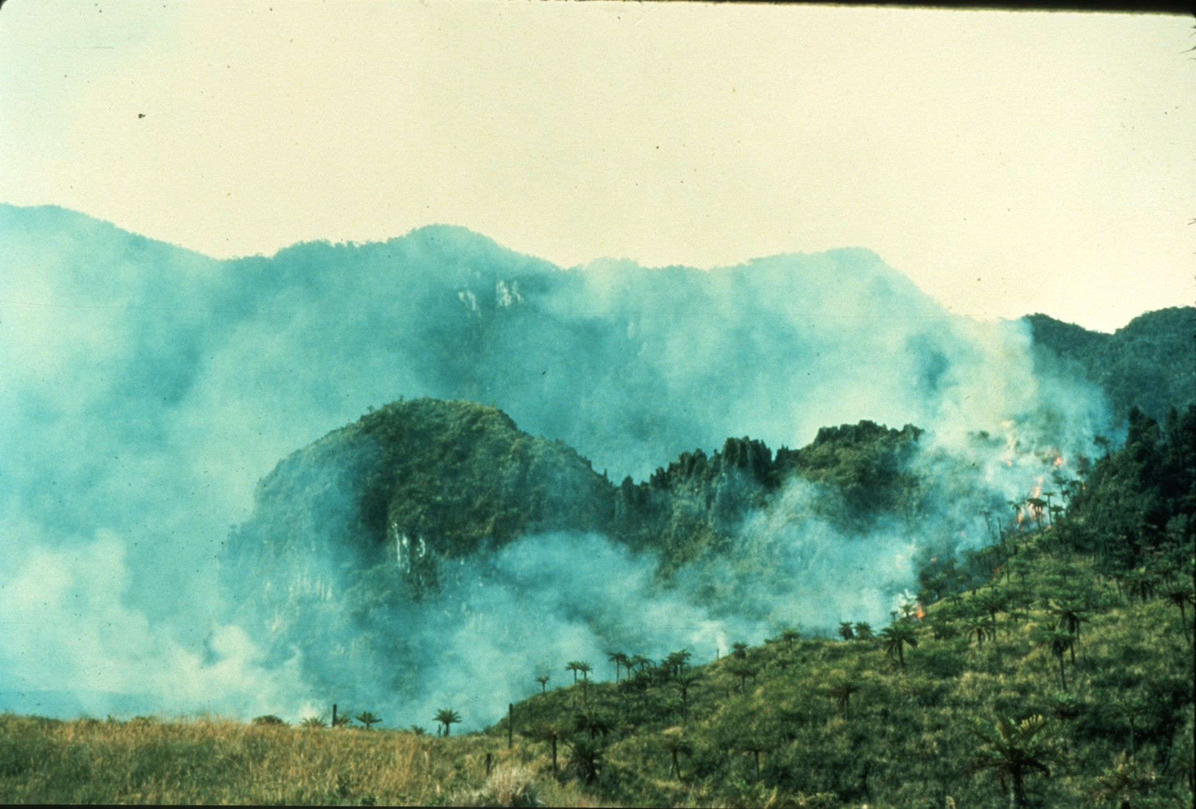
Notes:
The hunting party became bored and lit a fire to amuse themselves. It went out of control, forcing a hasty retreat.

Slide 47
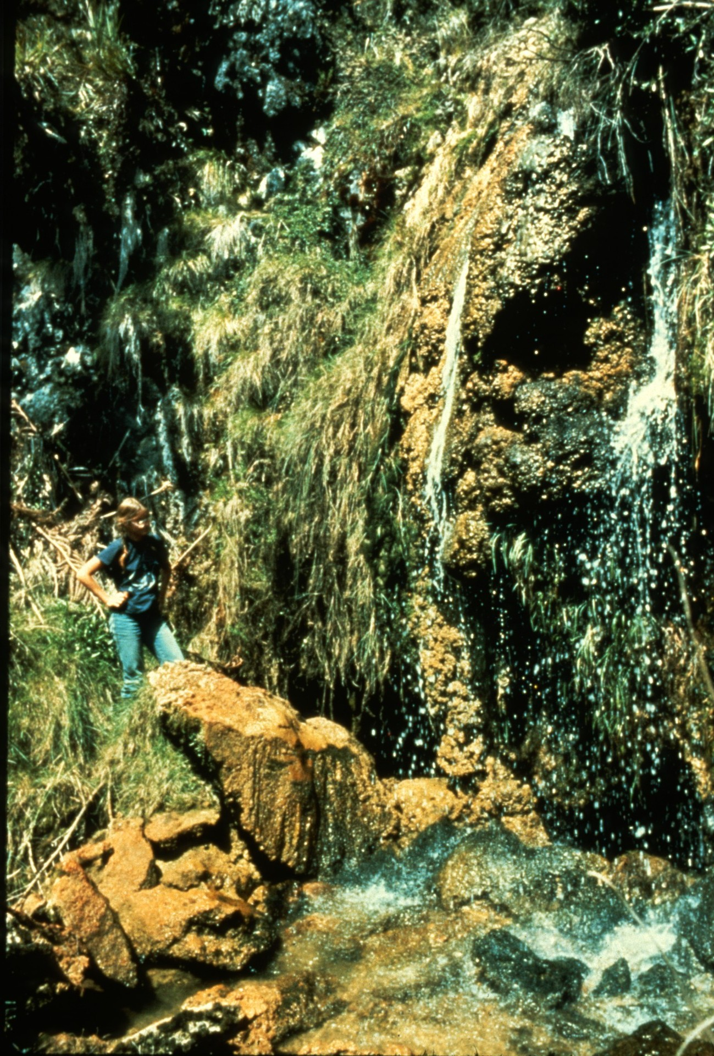
Notes:
In a distant corner of this clearing, a waterfall sank and was pushed 100' to a sump of liquid mud.

Slide 48
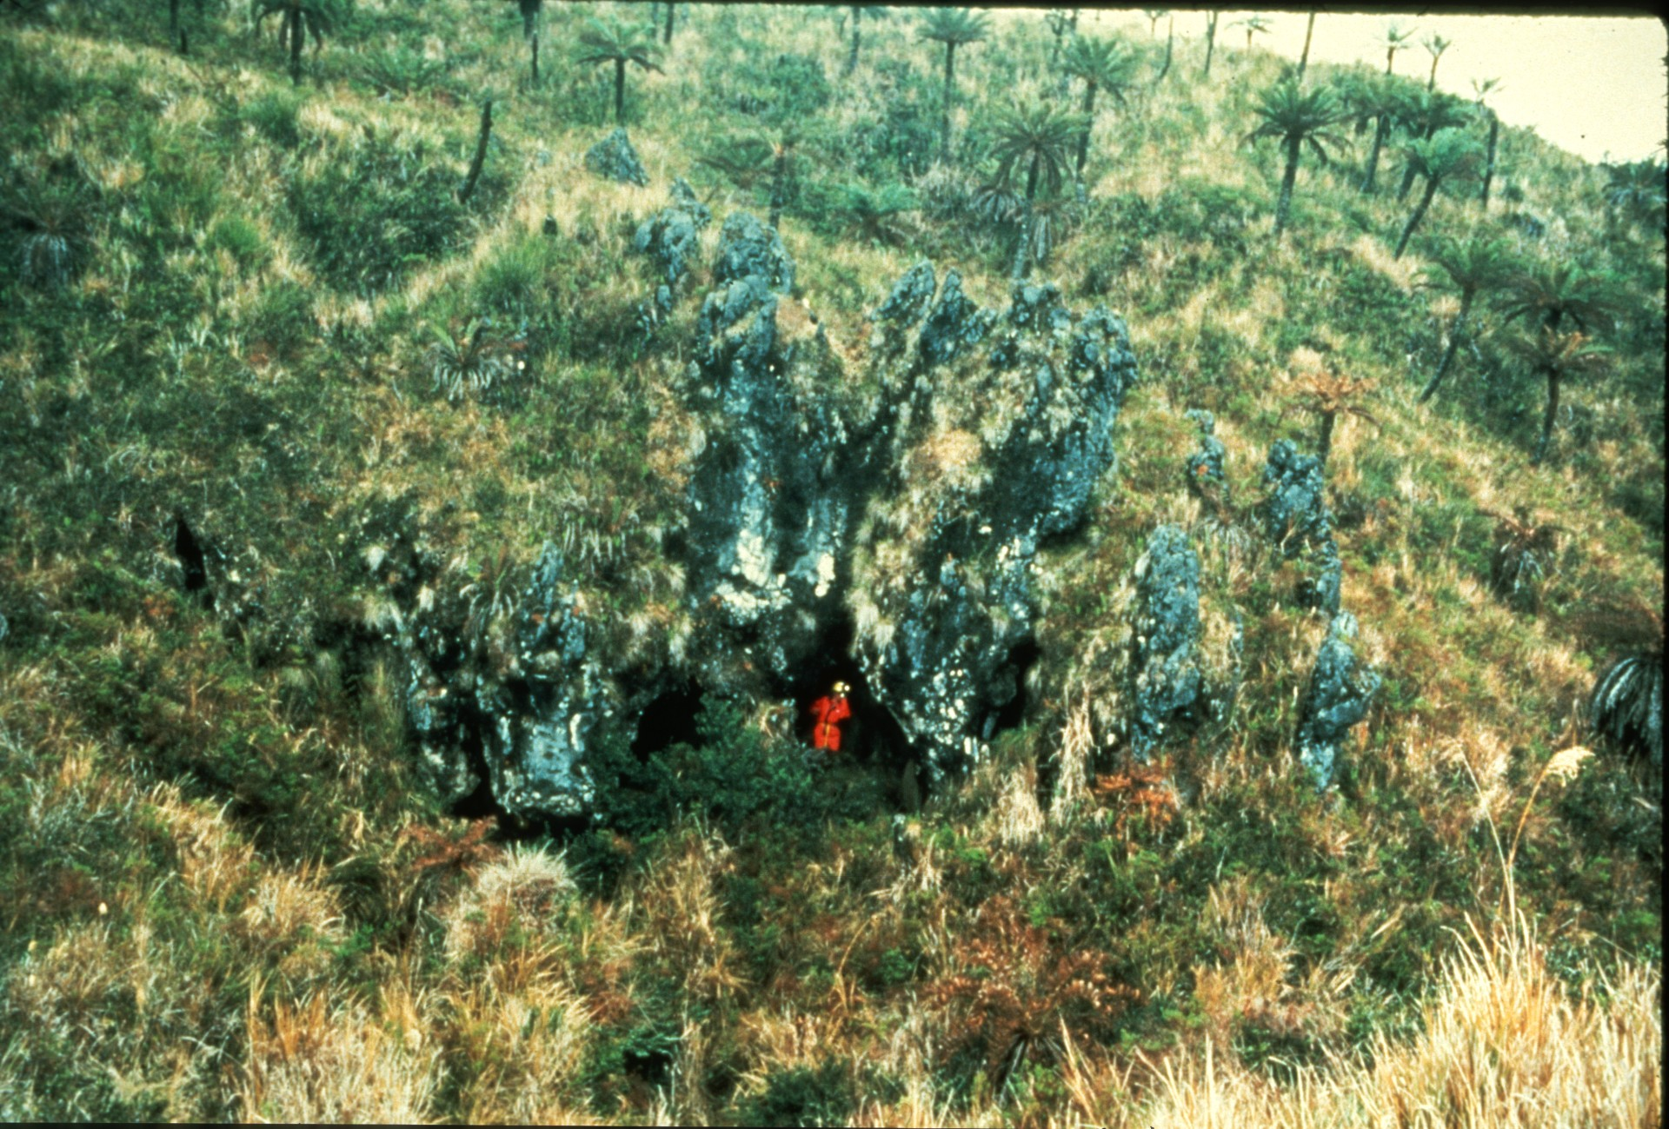
Notes:
Nearby, a small maze in an eroded pinnacle yielded the legbone...

Slide 49
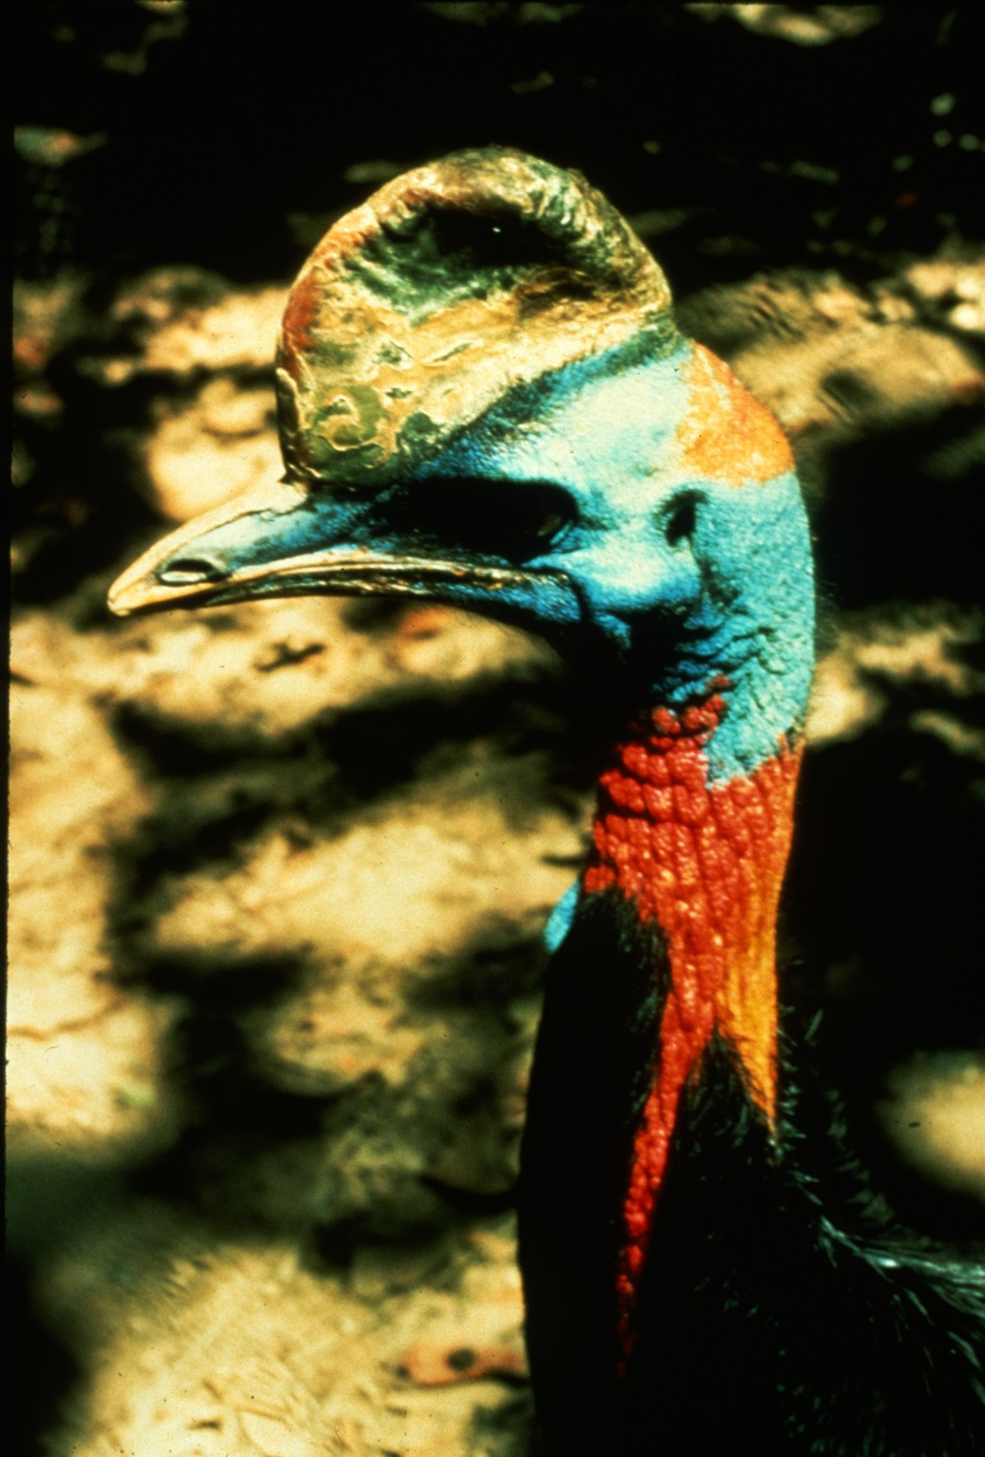
Notes:
Of a cassowary, a fierce, meter tall bird prized by natives.

Slide 50
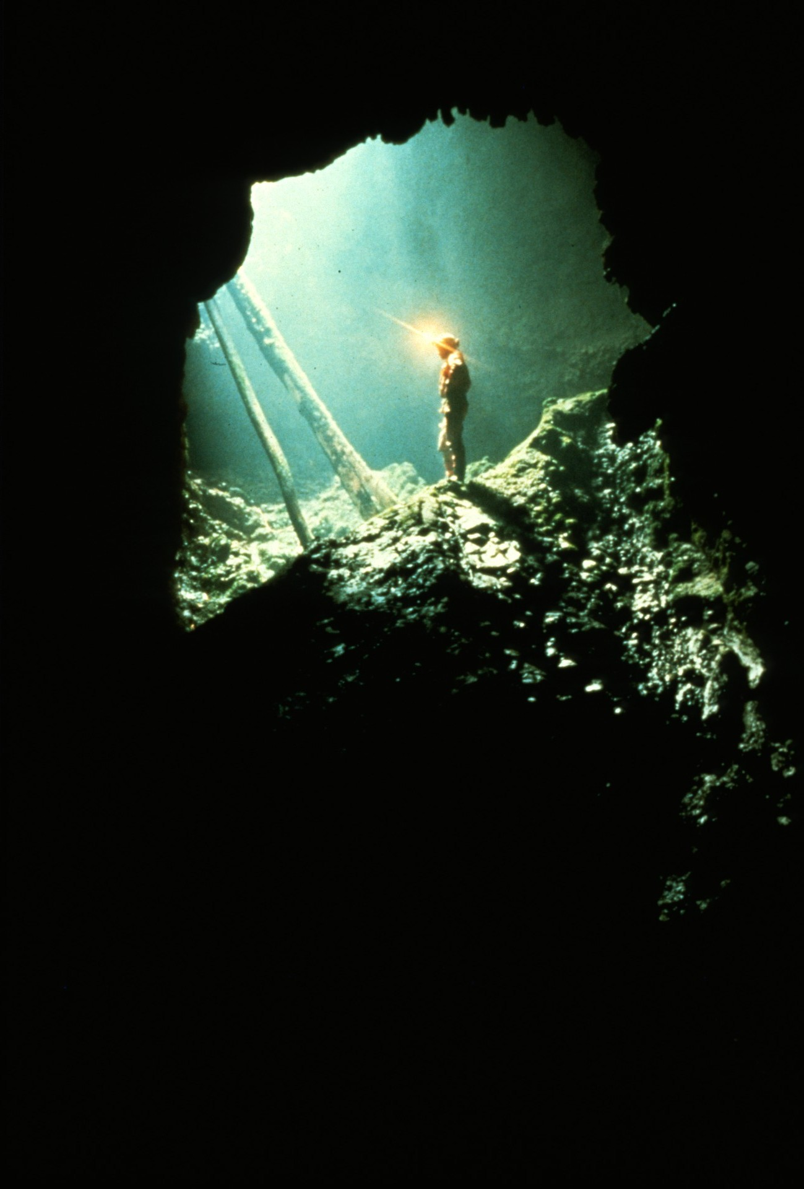
Notes:
An opening behind the pinnacle cave unexpectedly lead to...

Slide 51
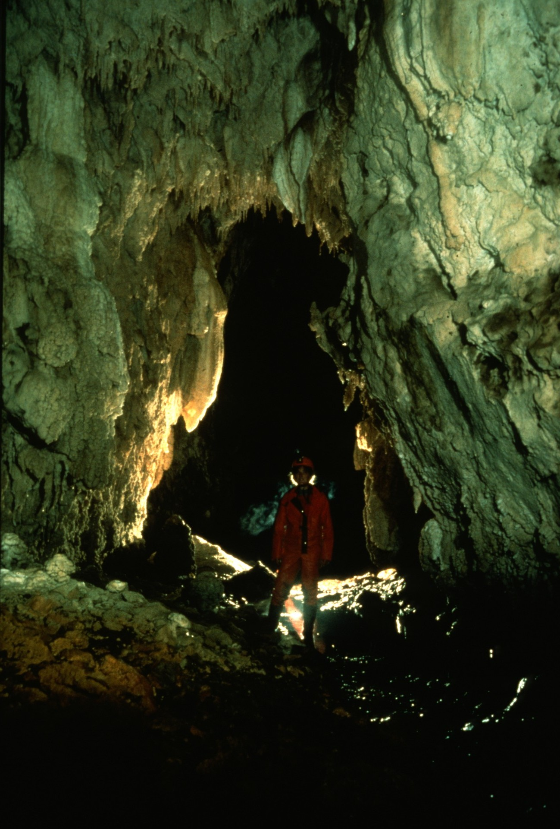
Notes:
a beautiful river passage emerging from the other end of the mud sump seen earlier in the waterfall cave.

Slide 52
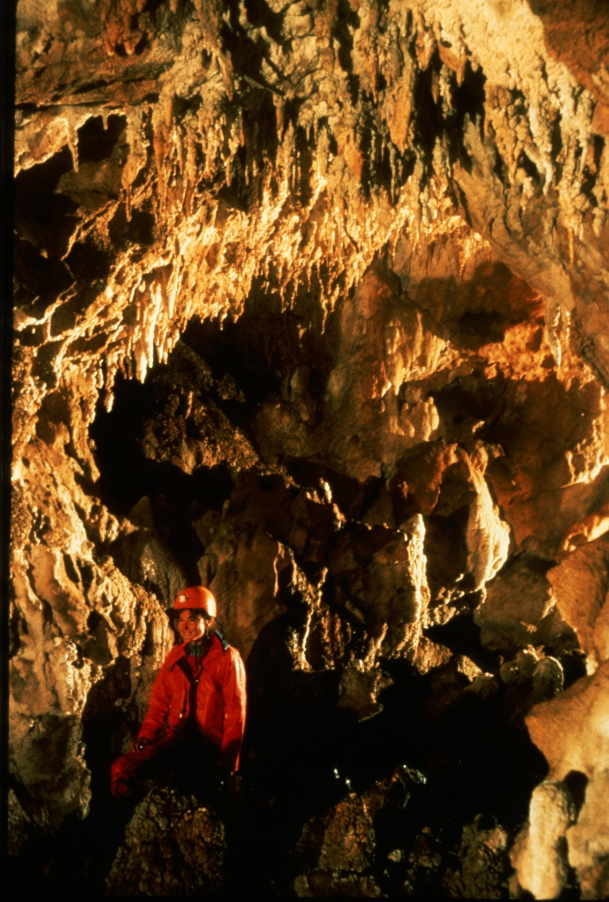
Notes:
Its 700 meters were well decorated...

Slide 53
Notes:
Because the stream passage was totally unexpected, the cave was named "Surprise River".

Slide 54
Notes:
Investigation of a nearby cliff...

Slide 55
Notes:
lead to a 60’ drop into a chamber illuminated by a spectacular sunbeam.

Slide 56
Notes:
Several kilometers away a team followed a stream canyon through several short tunnels...

Slide 57
Notes:
which finally lead to the main cave.

Slide 58
Notes:
Iba Lu Kundu was devoid of formations but contained attractive heavily scalloped walking passage.

Slide 59
Notes:
It also provided a first caving experience for a barefoot native.

Slide 60
Notes:
After each week-long foray into the wilds, teams returned to the comparative luxury of basecamp for cleaning and repairing gear and replenishing supplies.

Slide 61
Notes:
Because it lay beside a local hunting trail, basecamp received some interesting visitors.

Slide 62
Notes:
These colorful characters were interested in trading their handmade jewelry for anything from soap to old t-shirts.

Slide 63
Notes:
Encarle sports his bamboo smoking pipe, a "schmook-mambu."

Slide 64
Notes:
What would you trade for this tree kangaroo?

Slide 65
Notes:
After two months in the jungle the distinction between westerner and native became blurred.

Slide 66
Notes:
Even in the deep jungle, abandoned hunting shelters could be found and used by expedition teams.

Slide 67
Notes:
Near one such, a search for water lead to the unexpected discovery of this impressive pit.

Slide 68
Notes:
Still within sight of daylight, the Jailbreak passage lead to another large sinkhole entrance.

Slide 69
Notes:
Believing they had discovered the best cave of the trip, the discovery team christened it "Nambawan Ananda" (the best cave).

Slide 70
Notes:
Just inside the main entrance the cavers encountered a bat colony that was never seen again after the first trip.

Slide 71
Notes:
Profuse decorations were found in the very first chamber.

Slide 72
Notes:
The cavers traversed a muddy slope above a pit while echo-locating birds flew overhead.

Slide 73
Notes:
The Glossy-backed Swiftlets make an audible clicking sound which allows them to navigate to their homes deep in the cave.

Slide 74
Notes:
Large passages took off in all directions.

Slide 75
Notes:
Though no vertical gear was needed, slippery freeclimbs were common.

Slide 76
Notes:
The copious mud produced a variety of forms including these reminiscent of the pinnacle karst.

Slide 77
Notes:
The further the cavers pushed the more beautiful the cave became.

Slide 78
Notes:
The floor was so densely covered with cave pearls that portions of the formation room were never traversed.

Slide 79
Notes:
Pearls upon pearls...

Slide 80
Notes:
At one point the formations threatened to choke off the passage.

Slide 81
Notes:
The delicacy of the formations demanded that the teams take special care to preserve their beauty.

Slide 82
Notes:
At the far reaches of the cave was the Winter Wonderland, where floor to ceiling were covered with white calcite and delicate nests of pearls.

Slide 83
Notes:
This ring of pearls was little more than an inch in diameter.

Slide 84
Notes:
. At the end of the Wonderland was a delicate, pure white crystal pool. The smallest caver removed her muddy boots and coveralls to explore to an end shortly beyond.

Slide 85
Notes:
Jungle trekking was not without its hazards. Expedition member Jim Pisarowicz severely injured his leg by falling into a small pothole hidden by brush in a clearing...

Slide 86
Notes:
requiring a helicopter rescue arranged by radio.

Slide 87
Notes:
As with all expeditions the largest discovery was made at the end. A distant field camp was established to explore Leiwaro Kundu.

Slide 88
Notes:
Caving at this high elevation was cold, wet, and sometimes grim.

Slide 89
Notes:
The cave was pushed down a series of short pitches...

Slide 90
Notes:
Some requiring inventive rigging techniques.

Slide 91
Notes:
With time running out the cave was pushed to -300 meters with no end in sight.

Slide 92
Notes:
The promise of more cave and the primitive wilderness invite a return to the Highlands of New Guinea.

Slide 93
Notes:
The team assembled for a group shot on the helipad..

Slide 94
Notes:
The thirty expedition members represented five different countries.

Slide 96
An NSS Audio-Visual Library Presentation
Papua New Guinea
1982
Original slide program S734
Slides digitized by David Caudle
PowerPoint program created by Jim McConkey
96 slides, with script in presenter notes
PowerPoint created 2/07/2021
National Speleological Society
6001 Pulaski Pike
Huntsville, AL 35810-1122
256- 852-1300
nss@caves.org
https://caves.org/

